Slide 1

Overview of VITA & Volunteer Standards of Conduct

Slide 2
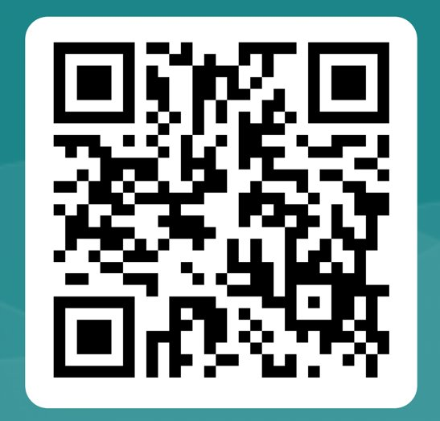
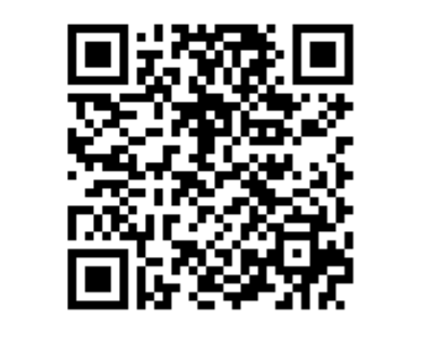
Email Sign-up Form Broad 360 Points
(Culture & Comm 20p)

Slide 3

Welcome to our inaugural tax bootcamp!
This is a series of weekly sessions hosted by the e-board (us!) as a guide for the certification exam and tax season
  These will run from now to the beginning of tax season in early February
While we will be hosting two sessions per week, we would only like for you to attend one per week
If you cannot attend either of the sessions, you can watch the videos on BetterImpact instead
  Those videos are not made by us, they are made by UWSCMI (our coordinating organization)
We will also be sending out these slides in our weekly newsletters for your reference
If you have any questions, feel free to reach out to the e-board at rso.msuvita@msu.edu

Slide 4
Disclaimer
We were just informed that in order to teach the material, we must be IRS certified.
However, due to the ongoing government shutdown, the IRS website is not being updated as frequently, and as a result, the certification exams covering the topics in today's session are currently offline.
We are here today to point you in the right direction for the certification exam, not to teach the materials to you.

Slide 5
Agenda
Overview of VITA Site Operations
Volunteer Standards of Conduct

Slide 6
Overview of VITA Site Operations
2025-2026

Slide 7
Roles at the VITA Site
Site Coordinator
Greeter
Intake Specialist
Tax Preparer
Quality Reviewer

Slide 8











Site Layout

Slide 9
Volunteer Standards of Conduct
2025-2026

Slide 10
Which exam(s) will I see this material on?
Basic Tax Preparer
Volunteer Standards of Conduct
Intake/Interview & Quality Review
Advanced Tax Preparer

Slide 11
Why do we have Volunteer Standards of Conduct?
To protect the client
To protect you (the volunteer)
To protect the program

Slide 12
VSC 1: Follow the 10 Quality Site Requirements
All volunteers must be certified at the appropriate level​
All volunteers must follow the correct intake/interview and Quality Review (QR) Process​
Volunteers must validate taxpayers’ identities and ID numbers (SSN or ITIN)​
IRS Reference materials must be available for use​
All volunteers must have ID verified and volunteer agreement signed​
All completed returns must be filed in a timely manner
Civil rights poster must be displayed at clients’ first point of contact
Correct SIDN must be reported on all prepared returns
Correct EFIN must be reported on all prepared returns
All information provided by taxpayers must be handled with care and kept confidential

Slide 13
VSC 2: No Compensation
Do not accept payments, solicit donations, or accept refund payments from clients
  We are a completely free service
  We cannot accept tips
  Clients are welcome to give positive feedback through surveys administered by our coordinating organization (UWSCMI)

Slide 14
VSC 3: No Benefits from Info
Do not solicit business from taxpayers you assist or use the knowledge gained about them for any direct or indirect personal benefit for yourself or any other specific individual
  We are a completely free service
  No gain from knowledge of clients
  No asking for someone’s number
  No drumming up business for another person or yourself

Slide 15
VSC 4: No False Return Prep
Do not knowingly prepare false returns
We correctly apply tax law based on a taxpayers’ situation
May cause additional issues for the taxpayer

Slide 16
VSC 5: Good Conduct
Do not engage in criminal, infamous, dishonest, notoriously disgraceful conduct, or any other conduct deemed to have a negative effect on the VITA program

Slide 17
VSC 6: Respect Taxpayers
Treat all taxpayers in a professional, courteous, and respectful manner
  Make sure that we do our due diligence when speaking with taxpayers
This standard of treatment applies to your fellow volunteers as well

Slide 18
Consequences of VSC Violation
  You could get banned from volunteering
    Depending on the severity of the violation, you could be placed on an IRS list that bars you from volunteering with VITA indefinitely
  MSU and UWSCMI could be prohibited from offering VITA in the future
  Engagement in criminal acts could result in prosecution, fines, and/or jail time

Slide 19
What you can do
There are a few actions you can take when someone behaves unethically:
1. Talk to your site coordinator
2. Talk to the e-board or another staff member
3. Email WI.Voltax@irs.gov
If you see something, say something.

Slide 20
Sample
Exam Questions

Slide 21
Question 1
If a taxpayer offers you a $20 bill because they were so happy about the quality service they received, what is the appropriate action to take?
a. Take the $20 and thank the taxpayer for the tip.
b. Tell the taxpayer it would be better to have the $20 deposited directly into your bank account from his refund.
c . Thank the taxpayer, and explain that you cannot accept any payment for your services.
d . Refer the taxpayer to the tip jar located on the quality review and print station.

Slide 22
Question 1
If a taxpayer offers you a $20 bill because they were so happy about the quality service they received, what is the appropriate action to take?
a. Take the $20 and thank the taxpayer for the tip.
b. Tell the taxpayer it would be better to have the $20 deposited directly into your bank account from his refund.
c . Thank the taxpayer, and explain that you cannot accept any payment for your services.
d . Refer the taxpayer to the tip jar located on the quality review and print station.

Slide 23
Question 2
Caiden prepares a tax return for Jesslyn at a VITA/TCE site. He finds out during the interview that Jesslyn has no health insurance. After Jesslyn leaves the site, Caiden writes her name and contact information down to take home to his friend who sells health insurance for profit. Which of the following statements is true?
There is no violation to the Volunteer Standards of Conduct (VSC) unless Caiden's friend makes a big commission on the sale of health insurance to Jesslyn.
Caiden has violated the VSC because he is using confidential information to engage in a financial transaction to further his own or another’s personal interest.
Caiden is doing Jesslyn a favor by using her personal information to secure business for his friend.
Information a taxpayer provides at a VITA/TCE site can be used for the volunteer’s personal gain.

Slide 24
Question 2
Caiden prepares a tax return for Jesslyn at a VITA/TCE site. He finds out during the interview that Jesslyn has no health insurance. After Jesslyn leaves the site, Caiden writes her name and contact information down to take home to his friend who sells health insurance for profit. Which of the following statements is true?
There is no violation to the Volunteer Standards of Conduct (VSC) unless Caiden's friend makes a big commission on the sale of health insurance to Jesslyn.
Caiden has violated the VSC because he is using confidential information to engage in a financial transaction to further his own or another’s personal interest.
Caiden is doing Jesslyn a favor by using her personal information to secure business for his friend.
Information a taxpayer provides at a VITA/TCE site can be used for the volunteer’s personal gain.

Slide 25
Question 3
Erich is an IRS tax law-certified volunteer preparer at a VITA/TCE site. When preparing a return for Susan, Erich learns that Susan does not have a bank account to receive a direct deposit of her refund. Susan is distraught when Erich tells her the paper refund check will take three or four weeks longer than the refund being direct deposited. Susan asks Erich if he can deposit her refund in his bank account and then turn the money over to her when he gets it. What should Erich do?
a. Erich can offer to use his account to receive the direct deposit, and turn the money over to Susan once the refund is deposited.
b . Erich should explain that a taxpayer’s federal or state refund cannot be deposited into a VITA/TCE volunteer’s bank account and she will have to open an account in her own name to have the refund direct deposited.
c . Erich can suggest she borrow a bank account number from a friend because the taxpayer’s name does not need to be on the bank account.

Slide 26
Question 3
Erich is an IRS tax law-certified volunteer preparer at a VITA/TCE site. When preparing a return for Susan, Erich learns that Susan does not have a bank account to receive a direct deposit of her refund. Susan is distraught when Erich tells her the paper refund check will take three or four weeks longer than the refund being direct deposited. Susan asks Erich if he can deposit her refund in his bank account and then turn the money over to her when he gets it. What should Erich do?
a. Erich can offer to use his account to receive the direct deposit, and turn the money over to Susan once the refund is deposited.
b . Erich should explain that a taxpayer’s federal or state refund cannot be deposited into a VITA/TCE volunteer’s bank account and she will have to open an account in her own name to have the refund direct deposited.
c . Erich can suggest she borrow a bank account number from a friend because the taxpayer’s name does not need to be on the bank account.

Slide 27
What's ahead?
Overview of US Income Tax System (next week)
Intake Process & Basic Federal Tax Forms
Federal Tax Concepts
Advanced Tax Forms
  Virtual Session for Returning Volunteers Only
Exam Review
  This session will take place during the final week of classes, so you can take the exams over the holiday break if you would like
State and Local Taxes
  When we return in January

Slide 28
Final Note
On BetterImpact, when you upload your government-issued ID to complete your background check, you DO NOT need to submit the Volunteer Standards of Conduct certificate with your ID.

Slide 29
Thank you!

Slide 30
Email Sign-up Form Broad 360 Points
(Cult & Comm 20p)

