Slide 1

Overview of State Tax Filing

Slide 2

Agenda
Introduction to State Tax Returns
Home Heating Credits
Homestead Property Tax Credit

Slide 3
Introduction to State Tax Returns
2025-2026

Slide 4
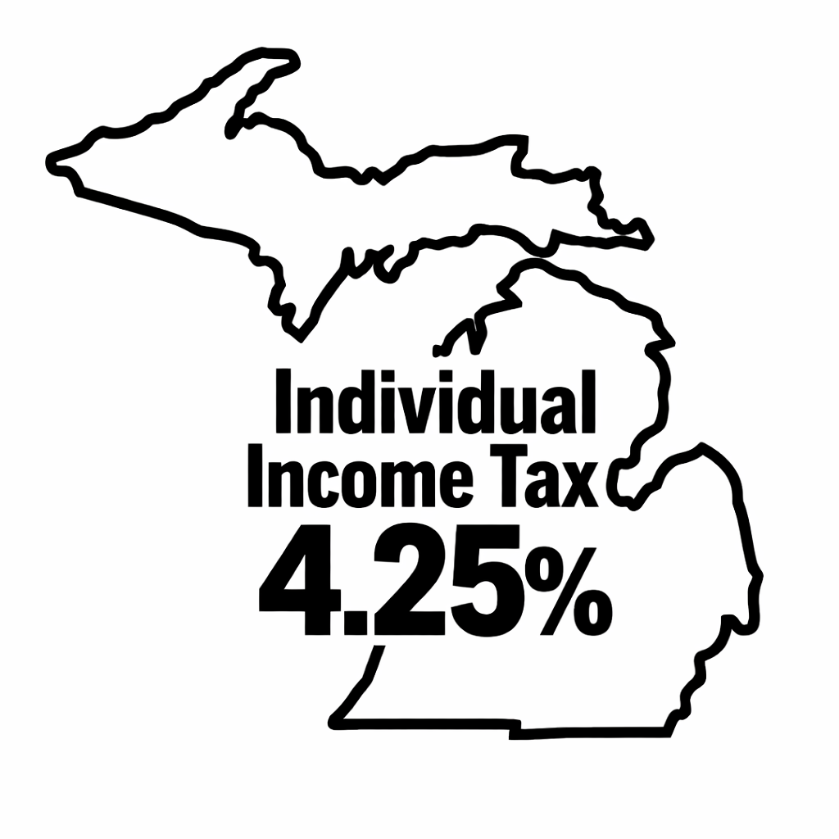
Tax Rate
Michigan uses a flat income tax, meaning all taxable income is taxed at the same rate. The current individual income tax rate in Michigan is 4.25%.

Slide 5
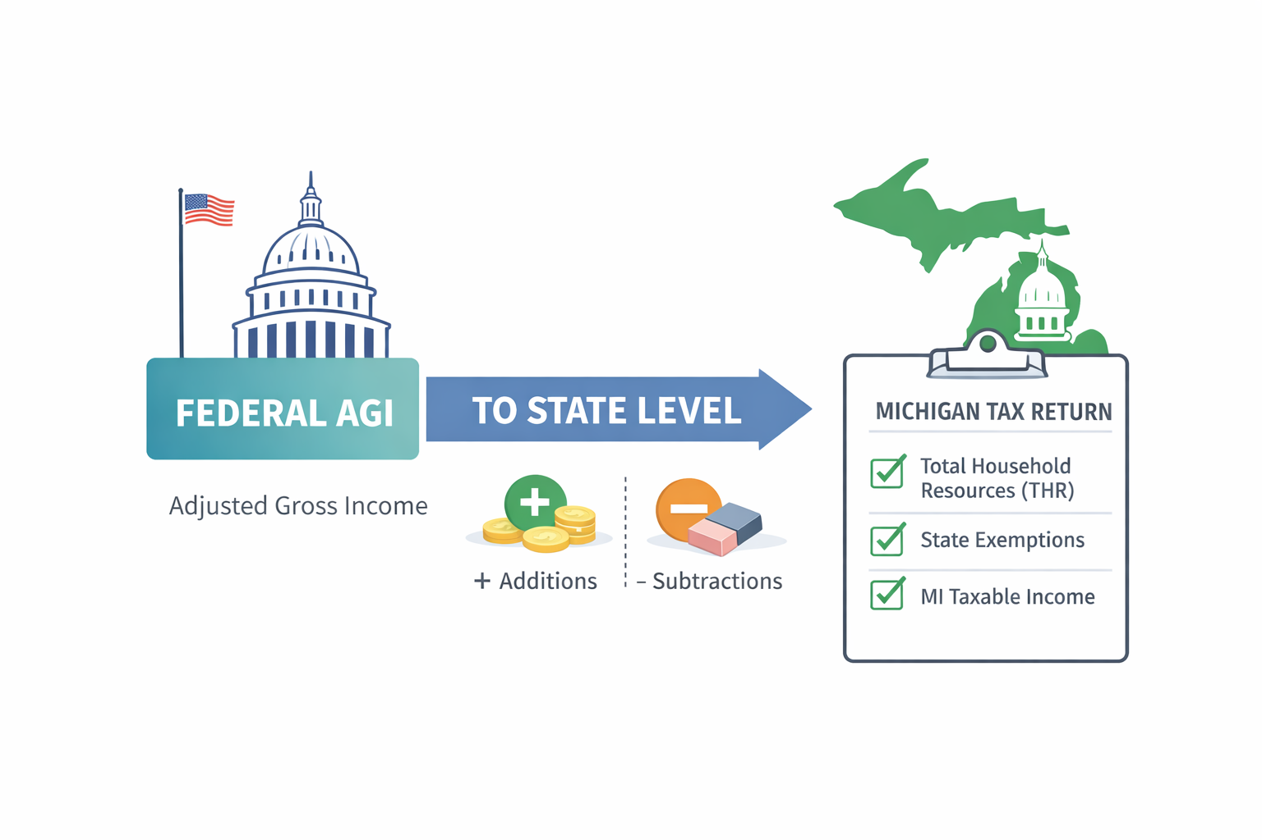
Taxable Income
Michigan calculates taxable income by starting with your federal Adjusted Gross Income (AGI), then applying Michigan-specific additions and subtractions, as well as allowable deductions and credits.
*Taxslayer Pro will automatically Calculate this for you!

Slide 6
Exemptions
Exemptions: Represent the number of people you can claim on your tax return. This amount is based on your filing status and the number of dependents you are eligible to claim.
For the Michigan state return, exemptions are used to calculate State Deductions (also called exemptions) and to determine Income Thresholds for certain credits.
Note: TaxSlayer automatically calculates your exemptions and applies them when preparing your Michigan state return.

Slide 7
Exemptions
$5,800 per individual
Additional $500 per qualified disabled veteran
$5,800 for stillbirth (per MDHHS certificate)
$1,500 on dependent's return
Special Exemptions
Disability Exemption of $3,400 per person can be applied if the taxpayer is deaf, blind, hemiplegic, paraplegic, quadripelgic, or 'Totally and Permanently Disabled'
The disability exemption cannot be claimed in 2025 if the individual is older than 66 years and 10 months (born before March 2nd, 1959)
Typically someone qualifies if they receive SSDI or SSI.

Slide 8
Total Household Resources
What is THR?
In Michigan, many tax credits are calculated using Total Household Resources (THR), which includes federal adjusted gross income (AGI) plus certain types of income that are excluded from federal AGI.
Why is THR Important?
Used to calculate the following Michigan credits:
Michigan Homestead Property Tax Credit
Michigan Home Heating Credit

Slide 9
Total Household Resource Deduction
Clients can deduct premiums paid out of pocket for the client and their family for:
Medical, Dental, and Vision Insurance (Includes Marketplace)
Prescription drug plans
Auto insurance* (only medical care portion)
*TaxSlayer automatically deducts Medicare premiums paid if reported on the SSA-1099 in the federal section

Slide 10
Homestead Property Tax Credit
2025-2026

Slide 11
Homestead Property Tax Credit (HPTC)
The Homestead Property Tax Credit (HPTC) is a refundable tax credit based on property taxes levied against a Michigan homeowner or renter
To qualify for this credit, the taxpayer must:
•Have a total household resources of $69,700 or less for TY 2025
•rent or own a home with a taxable value of $165,400 or less
•If a renter, they must be under a lease/rental contract and live in taxable housing
•Pay either property taxes or rent (may only claim their portion if shared expense)
•Reside in Michigan for 6 months or more during the tax year

Slide 12
HPTC for Homeowners
For homeowners, HPTC is calculated using property taxes levied on their home and its taxable value for the year.
This information can be located on their summer and winter property taxes on BS&A Online
Taxpayers may only include the property taxes for their main home/lot
To calculate property taxes levied:
Locate the total amount charged on the property tax statements
Subtract any charges with a millage rate of 0.0 from the statement amount
Subtract any interest charges from the statement amount
Add winter and summer tax statements for the total property taxes for the total property taxes levied on the home (include admin fees)

Slide 13
HPTC for Renters
In TaxSlayer, enter the rental address details along with the monthly rent amount and the number of months paid at that amount.
If the rent changed during the year, add the updated amount and months paid at that amount.
You may have to use BS&A Online to find the name of the landlord, or the locality the apartment is located in.

Slide 14
Special Cases for HPTC
•Tax Exempt Housing: These properties have agreements with their municipality and do not pay property taxes. If a client lives in tax exempt housing, they cannot claim the Homestead Property Tax Credit.
•Service Fee Housing: These properties pay service fees instead of property taxes and need to be entered differently into TaxSlayer.
•Nursing/Care Homes: The properties often charge tenants for other services, and clients will need information on their prorated portion of property taxes or an itemized bill with rent separated from other costs
•Co-operative Housing: These properties operate similarly to rentals, but the residents own a portion of the co-operative system. Clients will need to know the amount of shared property tax they paid during the tax year

Slide 15
Home Heating Credit
2025-2026

Slide 16
Home Heating Credit (HHC)
Unliked most tax credits, the Home Heating Credit generally does not go to directly to the taxpayer who receives it. Instead, this credit will often go to the client's heat provider and reduce the cost of heating bills.
In order to file a Home Heating Credit for your client, you will need to:
  Verify that their name is on the heat bill for their home
  Meet the income thresholds required for this credit (shown on the next page).
  Determine the type of heat they have and their heat provider
    General rule of thumb: Natural Gas → Consumers Energy; Electric → BWL
  Record the amount they paid for heat during the tax year, if amount is available

Slide 17
Home Heating Credit (HHC)
To qualify for the Home Heating Credit, the taxpayer:
•Must own a home or pay rent for a homestead in Michigan
•Must have total household resources within the limits allowed (See table)
•Must not live in college or university-operated housing
•Must not be a student claimed as a dependent by someone else
•Must not live in a licensed care facility for the entire year
General rule of thumb: if AGI < $20,000; fill out the Home Heating Credit section on TaxSlayer
Exemptions | Standard Allowance | Max THR to Qualify
0 or 1 | $581 | $16,586
2 | $788 | $22,500
3 | $995 | $28,414
4 | $1,202 | $34,328
5 | $1,409 | $40,243
6 | $1,616 | $46,157
>6 | +$208 per extra exemption | +$5,943 per extra exemption
•You do not have to memorize this table and you will not be tested on it; the tax software calculates the HHC for you!*

Slide 18
What's ahead?
Local Taxes (next week!)
Run-through of Tax Clinic
Tax Clinics begin the week of February 2nd
Need help with the IRS Certification Exams? Please come see us!

Slide 19
Thank you!

