Slide 1

Intake Process & Basic US Tax Forms

Slide 2

Agenda
Intake Process
Basic Tax Forms
How to input forms onto taxslayer

Slide 3
Intake Process
2025-2026

Slide 4
Which exam(s) will I see this material on?
Volunteer Standards of Conduct
Intake/Interview & Quality Review
Basic Tax Preparer
Advanced Tax Preparer

Slide 5
What is the Intake Process?
The intake process is required to:
  Ensure the return is within scope to the VITA/TCE program
  Determine the volunteer certification level needed for the preparation of the return
  Verify the taxpayer identity and documents
  Walk the client through the entirety of the Form 13614-C
  Explain the tax preparation process and aid the taxpayer to complete the return

Slide 6
Client Intake – What is Form 13614-C?
Form 13614-C, Intake, Interview, & Quality Review
Form 13614-C is :
The intake form developed by the IRS-SPEC office – the part of IRS that administers the VITA program
Designed to capture the information that is needed to prepare a complete and accurate tax return
Note*
The form 13614-C is not used for non-Resident Alien returns. These returns are captured through the Form 13614-NR
Updated every year to reflect procedural and tax law changes
Designed to help preparers avoid common errors that have been observed at many VITA sites

Slide 7
All VITA programs nationwide are required to complete Form 13614-C for every tax return prepared
The entire form must be completed, either by the taxpayer or by VITA staff
Every question must be answered "yes" or "no", ask questions to clarify any "unsure" answers
VITA staff must review and discuss Form 13614-C with every taxpayer

Slide 8
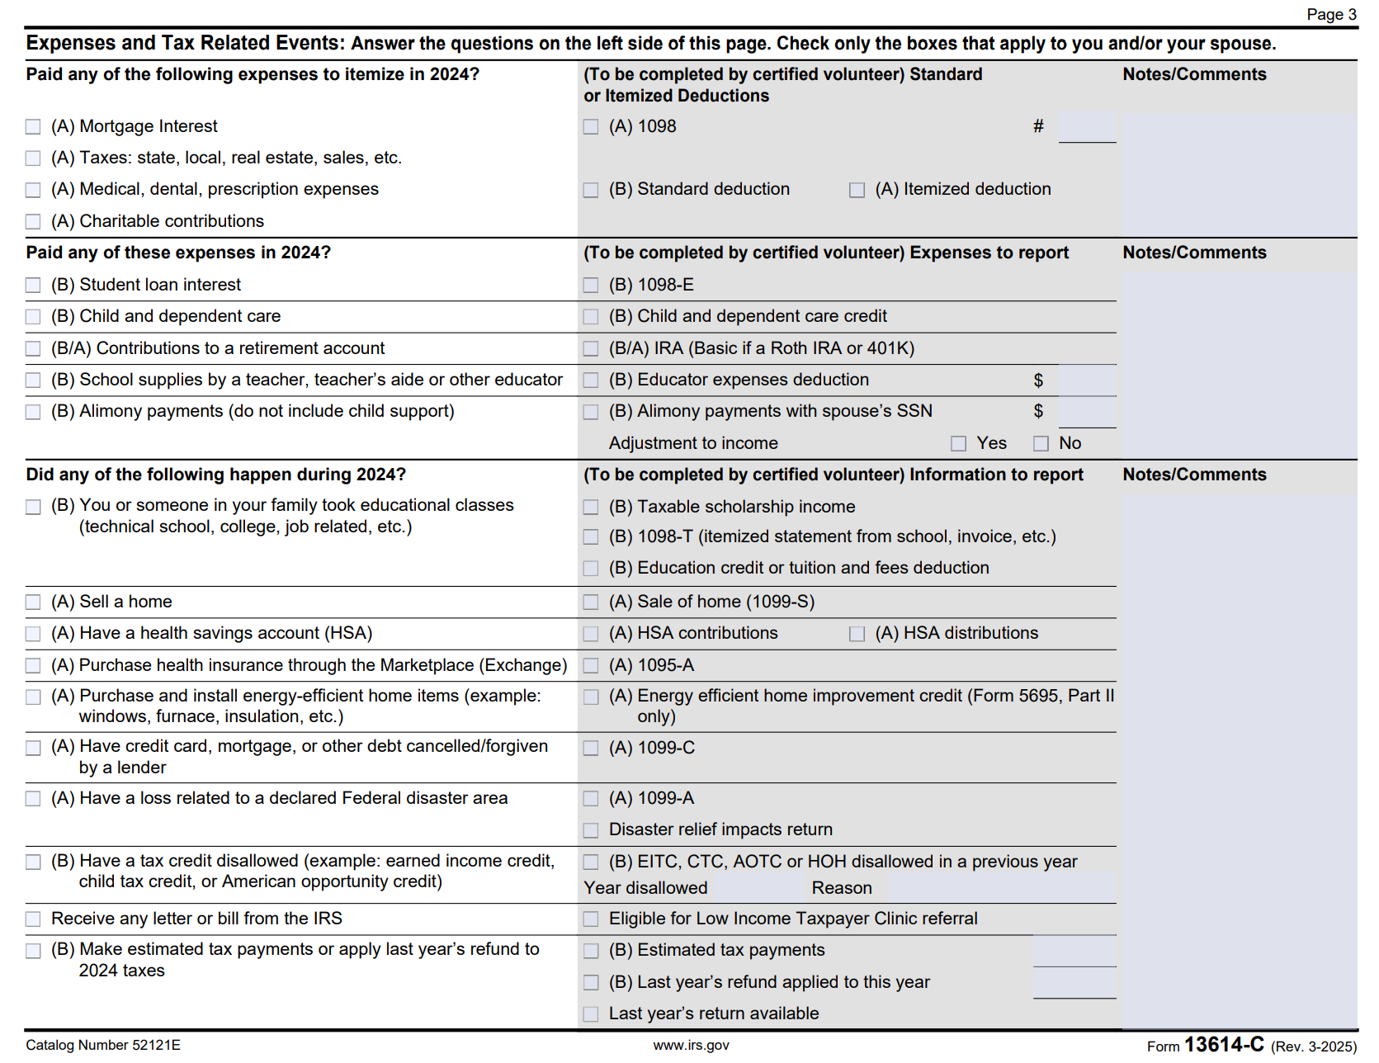
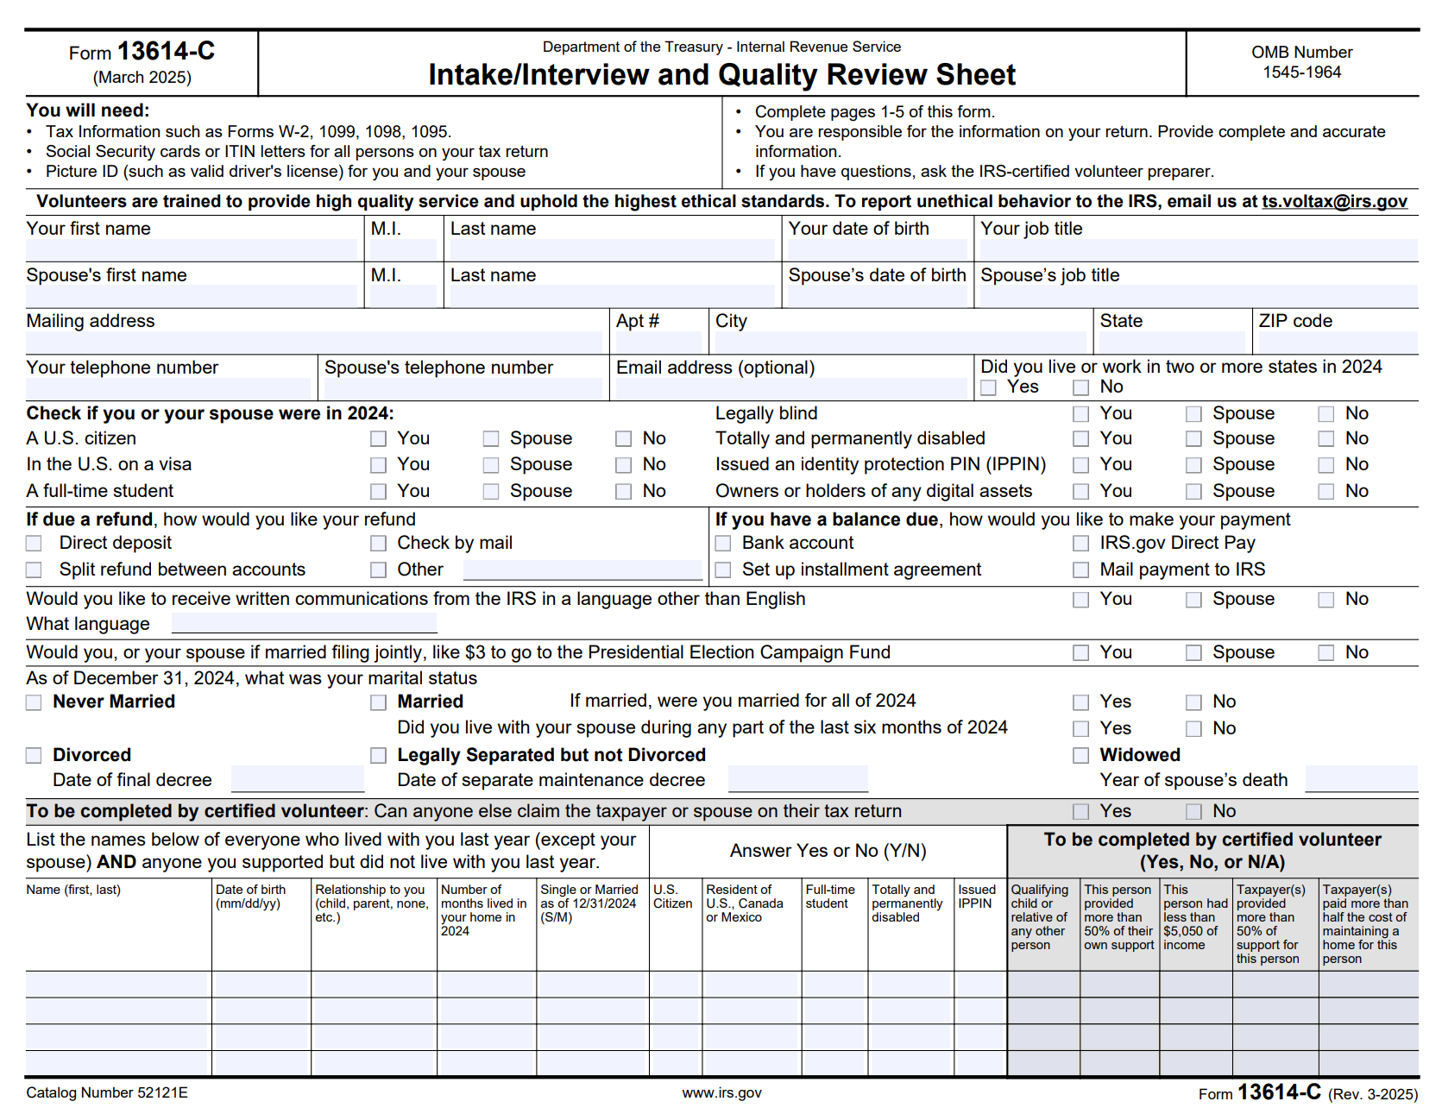
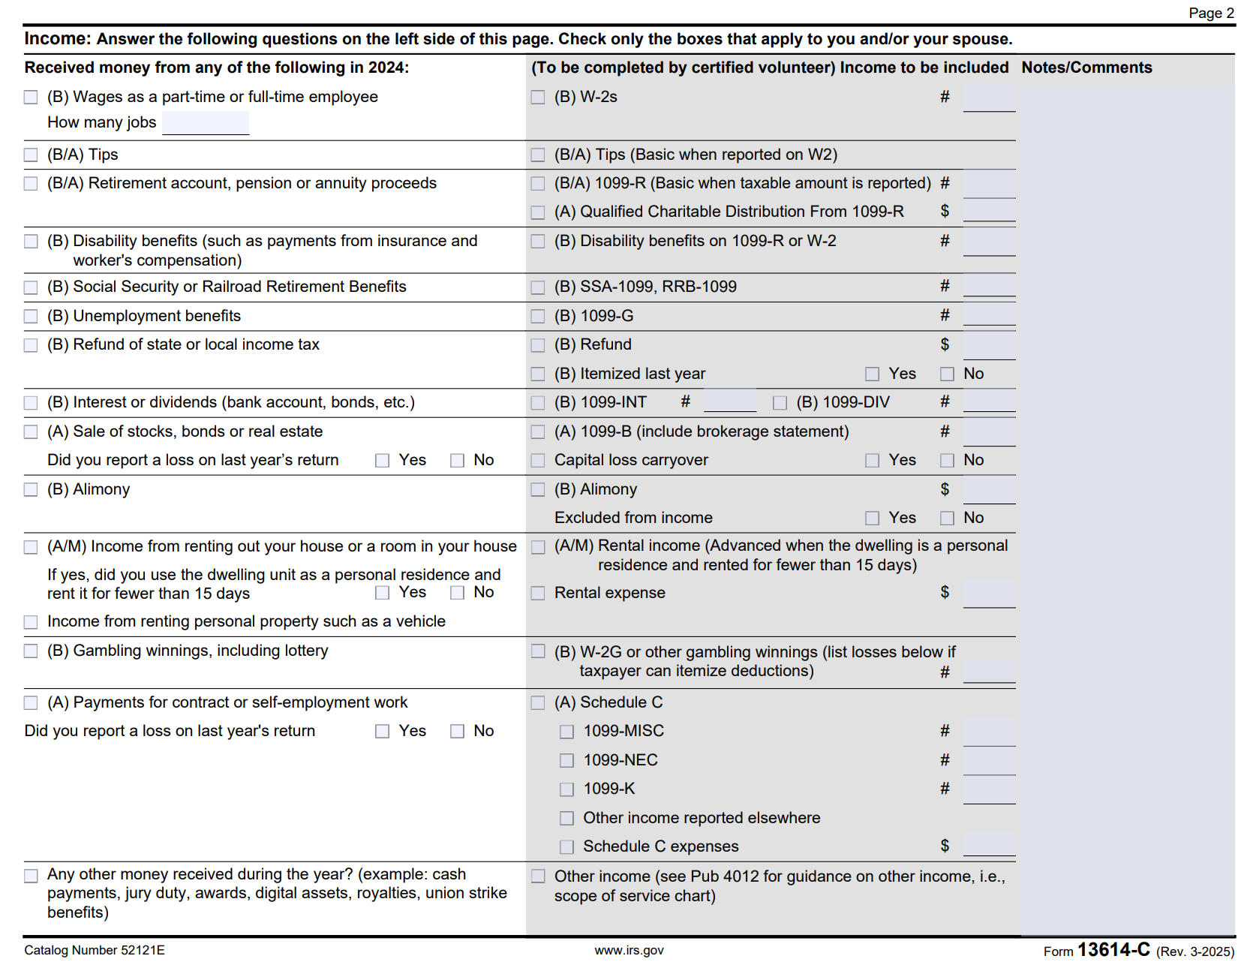

Slide 9
Photo ID
All taxpayers listen on the return must present a valid photo ID
  Dependents do not need a photo ID
  Driver's License
  State Issued ID Card
  Employer ID
  School ID
  Military ID
  National ID, Visa, or Passport
For MFJ returns, review the photo ID for both taxpayers. MFJ have to use their legal names (the names on the document).
Notes:
Question for Jacob: What do we do if the taxpayer does not match the photo ID?

Slide 10
Social Security Card
Taxpayers should provide original or copies of Social Security Cards for all individuals who will be on the return
The tax return must be prepared using the correct Social Security Number and the person's correct name as shown on one of these:
  Social Security Card
  Form 1099-SSA
  Letter or verification document issued by the Social Security Administration
  *Entering name and numbers sounds easy. But incorrect names or Social Security Numbers is a big cause for rejected tax returns and delayed refunds

Slide 11
ITIN Letter or Card
No Social Security Card or Number?
If the taxpayer does not have a social security number, ask to see their ITIN (Individual Taxpayer Identification Number) letter or card.
  An ITIN is a tax identification number issued by IRS to taxpayers who do not qualify to get a social security number
  ITINs are issued by the IRS when the taxpayer is an international student/fellow
  ITINs are permanent
*ONLY site coordinators are allowed to approve exceptions to ID requirements

Slide 12
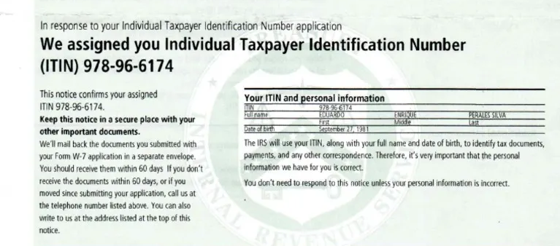

Slide 13
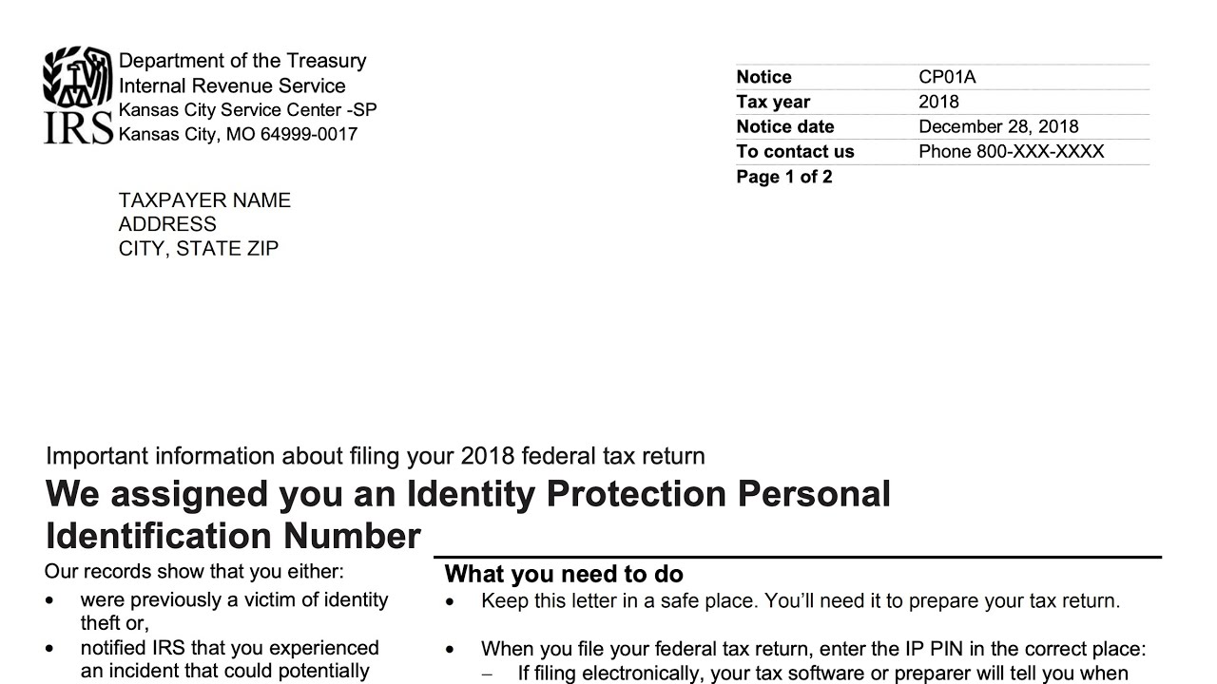
IP (Identity Protection) PIN
An IP PIN is a six-digit number issued by the IRS to help prevent someone else from filing a fraudulent tax return using the taxpayer’s SSN or ITIN
  Taxpayers typically receive IP PINs if they were confirmed victims of identity theft
IP PINs are temporary and confidential between the taxpayer and the IRS
If the taxpayer receives an IP PIN, the IRS will automatically reject their return if the IP PIN is not included in the tax return.

Slide 14
Common Out-of-Scope Situations
Cancellation of debt if...
  Other than qualified principal residence indebtness or nonbusiness credit card debt
Income – Wages, interest, etc.
  Farm income
  Tax returns for ministers and members of the clergy
  Any sale of digital assets (i.e. cryptocurrency, NFTs) throughout the tax year

Slide 15
Common Out-of-Scope Situations
Income – Business (most common out of scope items)
  Net losses
  Expenses over $10,000
  Cost of goods sold (inventory)
  Business use of home
Income from Partnerships and Rentals
  Any Schedule K-1
  Royalty income reported on Form 1099-MISC with associated expenses
  Rental income (including Airbnb) and expenses for non-military taxpayers

Slide 16
Pop Quiz!
If a taxpayer sells cryptocurrency during the tax year, is that out of scope for the VITA program?
Yes
No

Slide 17
Pop Quiz!
If a taxpayer sells cryptocurrency during the tax year, is that out of scope for the VITA program?
Yes
No
We CANNOT perform tax services for clients who sold cryptocurrency. Be sure to ask the client about this during the intake process!

Slide 18
Pop Quiz!
What are the two things required for us to prepare a client's tax return?

Slide 19
Pop Quiz!
What are the two things required for us to prepare a client's tax return?
A valid Photo ID and the SSN/ITIN of the taxpayer(s).

Slide 20
Basic Tax Forms
2025-2026

Slide 21
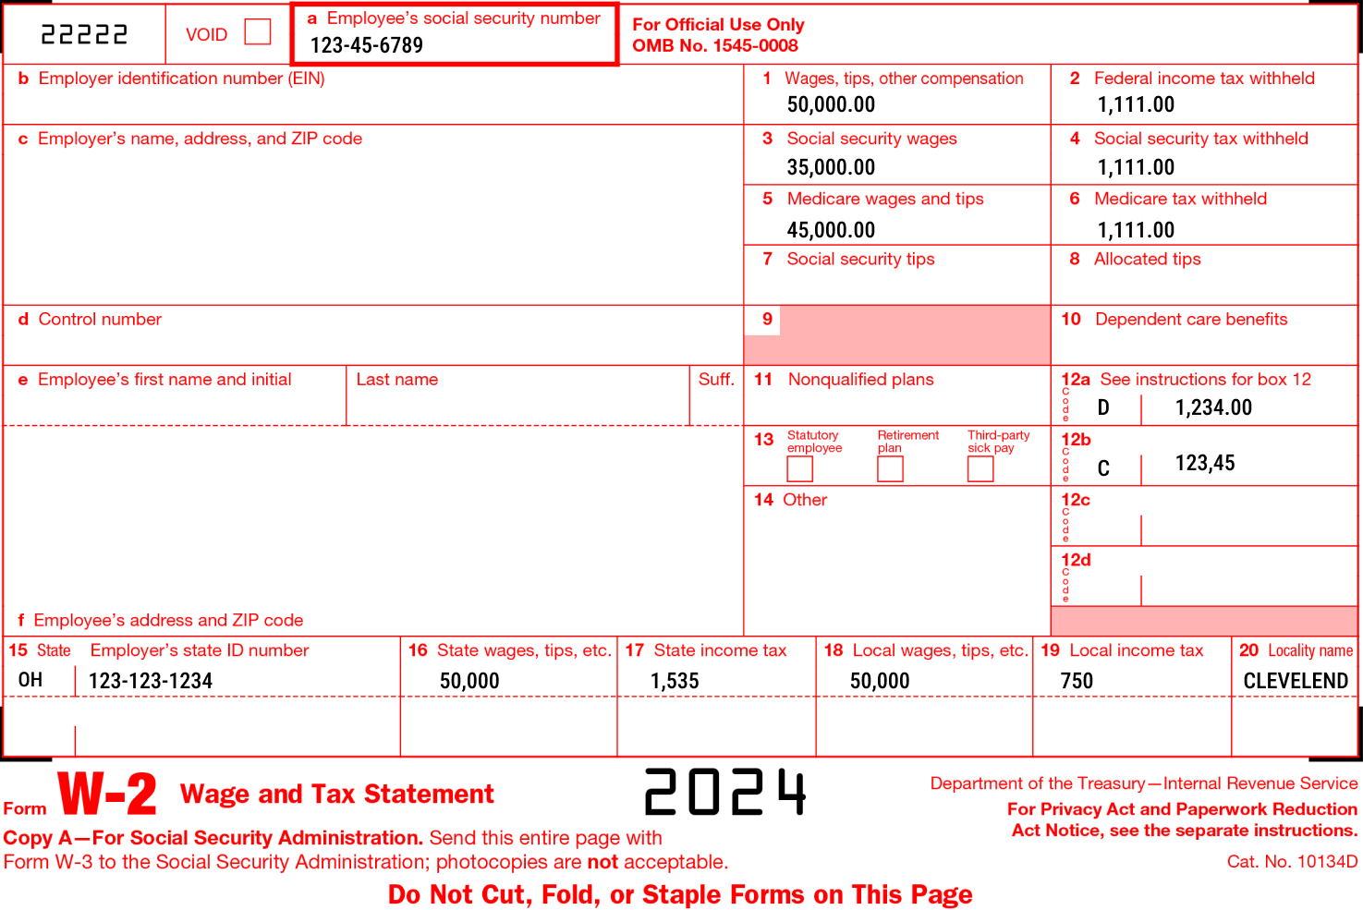
W-2
Shows your yearly wages and the taxes withheld from your pay.
(B) Employer Identification Number
(1) Total Income earned throughout the year
(4 & 6) FICA Tax deductions
  1.45% for Medicare
  6.2% for Social Security
(2, 16, and Other) Tax Withholdings:
  Federal
  State
  Local

Slide 22
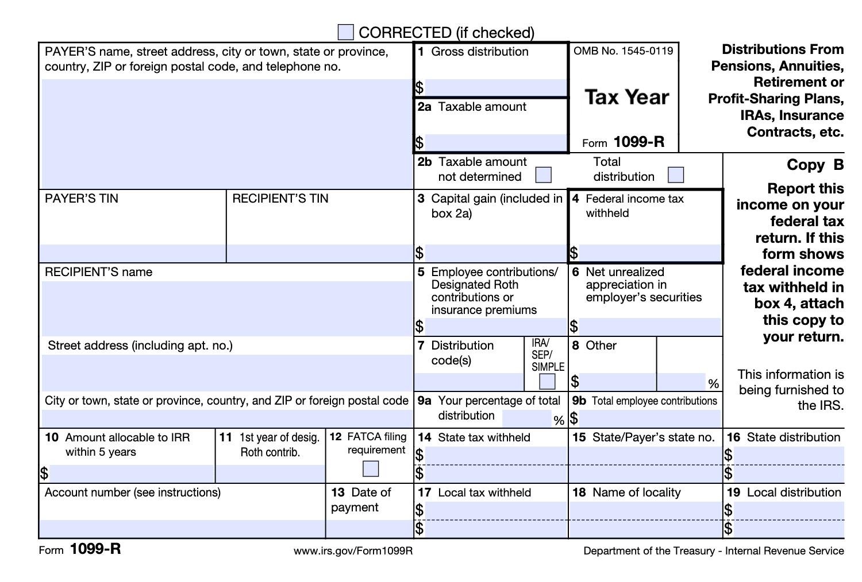
1099-R
Reports distributions (money paid out) from retirement accounts
Common sources include pensions, annuities, 401(k)s, IRAs, and insurance contracts
Shows how much money was paid to the taxpayer for the year, how much of that money is taxable, and taxes withheld for those payments

Slide 23
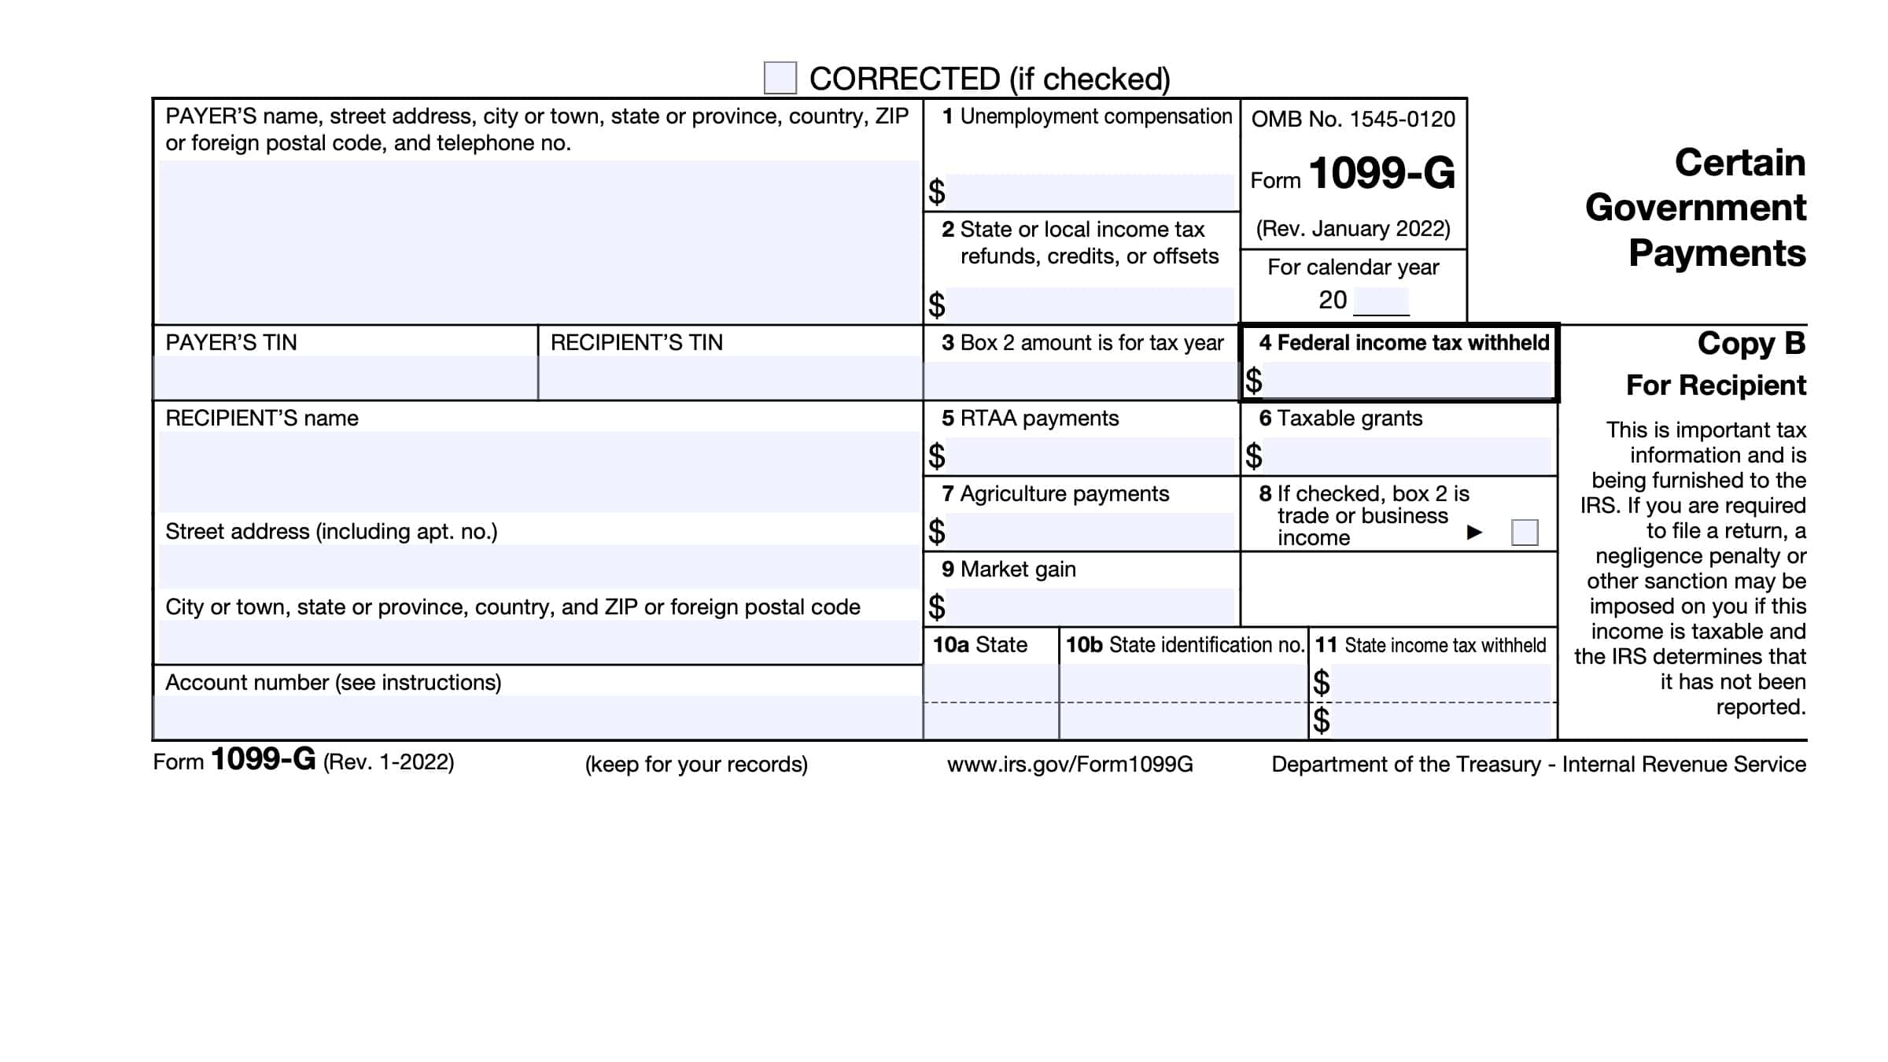
1099-G
Reports certain types of government payments received during the tax year.
Commonly used to report unemployment compensation and tax refunds from state & local governments
Summarizes any taxable government payments you received and any taxes withheld from them.

Slide 24
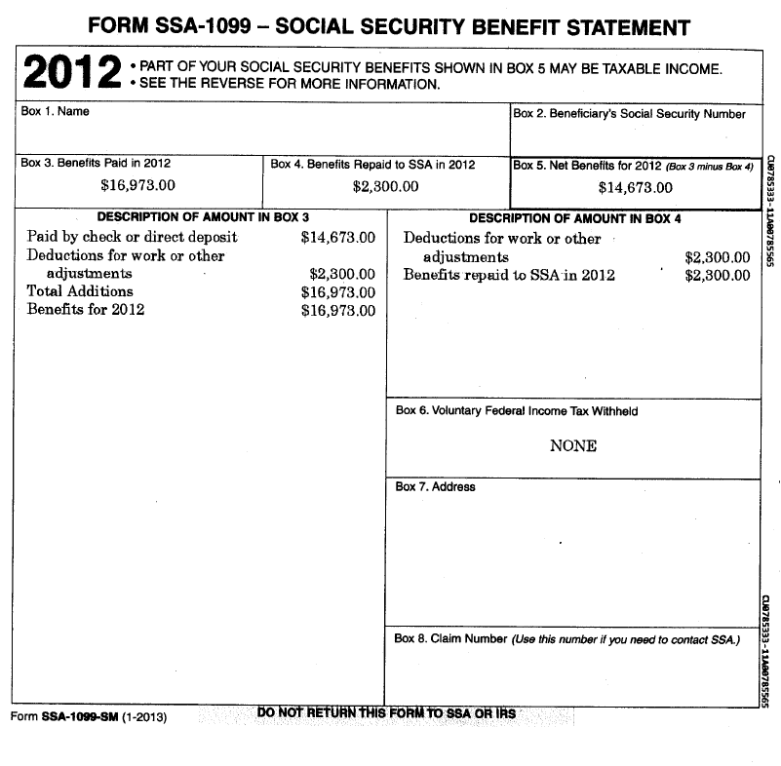
SSA-1099/1042-S
Sent to people who received Social Security benefits during the year
Reports the total amount of benefits received, benefits repaid (if any), and Medicare premiums deducted from checks
Used to figure out if social security benefits are taxable (not all are)
If the taxpayer does not provide a social security card during the intake process, this can be used to input their SSN

Slide 25
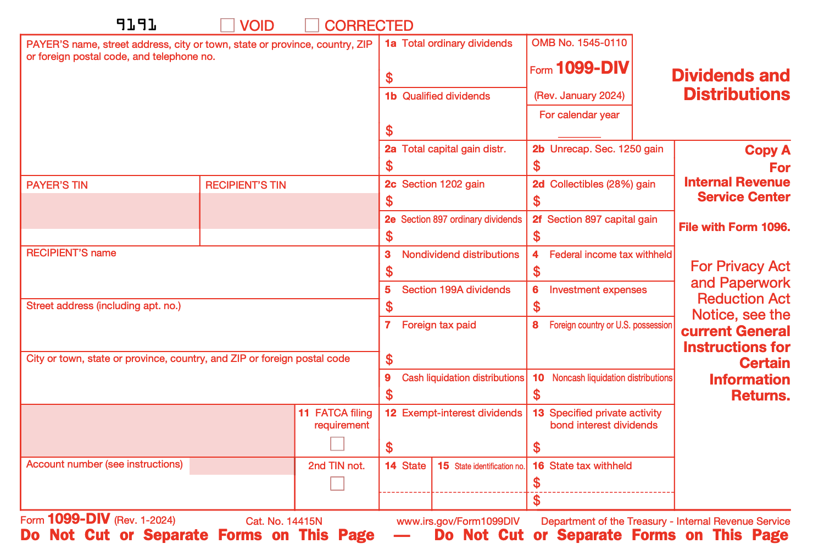
1099-DIV
Form 1099-DIV is used by banks and other financial institutions to report dividends and other distributions to taxpayers and to the IRS.
  Used for dividends and capital gain distributions from investments like stocks or mutual funds

Slide 26
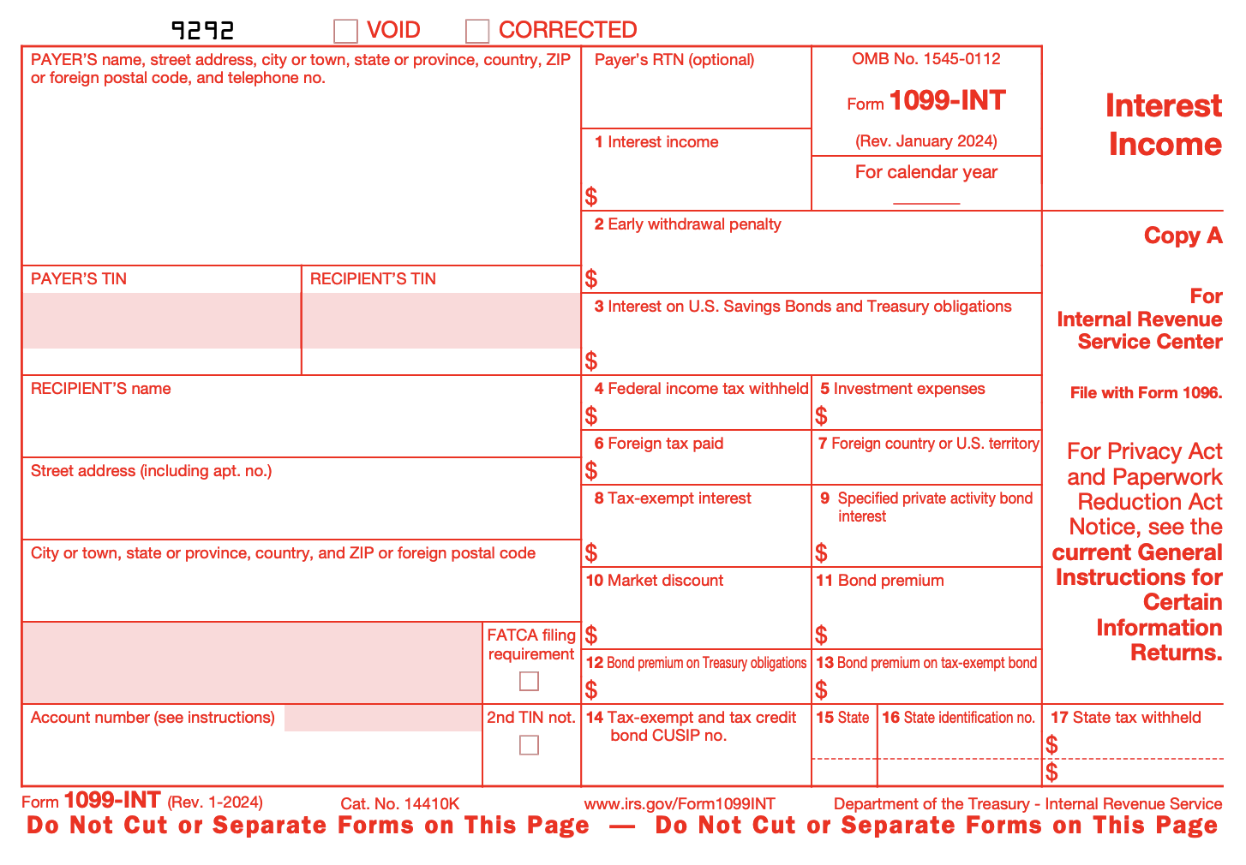
1099-INT
Form 1099-INT is used by banks, credit unions, and other financial institutions to report interest income you've earned during the year.
If you received $10 or more in interest from a single institution, you'll get this form by January 31 of the following year.

Slide 27
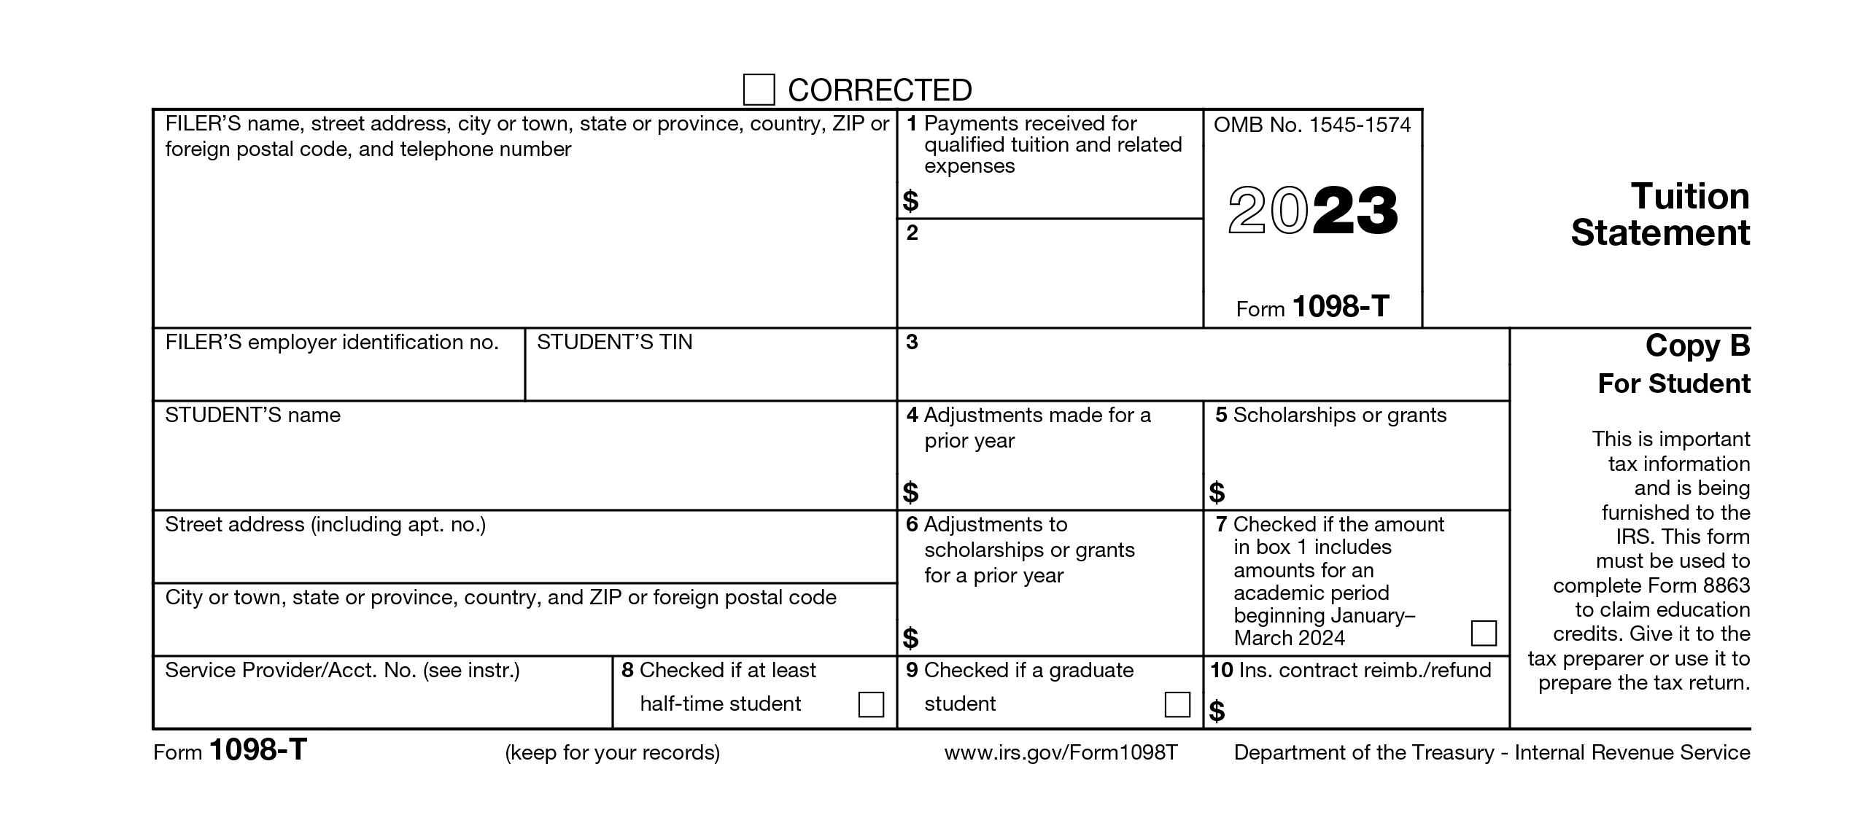
1098-T
Sent to college students (or their parents) by the school
Reports qualified tuition and related education expenses paid during the year
Shows scholarships or grants received, which may reduce the amount of eligible expenses
It does not show how much money was actually paid out-of-pocket
Used to determine if the taxpayer qualifies for educational tax credits
  We will talk more about these next week

Slide 28
Inputting Tax Forms Into TaxSlayer Pro
2025-2026

Slide 29
W-2
Enter Employer EIN (Section - b)
Enter Business Name (Section - c)
Enter Company Information (Address, Zip Code, City, State)
Enter Wages and Federal Withholding (Boxes 1-11)
Enter Information from Box 12 & 14 into the software, (Boxes 12 &14)
Verify FICA Withholdings and Wages Match W-2
  Make corrections if needed.
Enter Michigan (MI) State Withholdings & Other Info (Boxes 15-17 + Employers State ID Number)
  Sometimes the State employer EIN differs from the Federal EIN. Confirm that the EIN matches the W-2.
Enter Locality Withholdings *if applicable, (Boxes 19-20)
  Tax software does not allow inputting more than one locality at a time.
If multiple localities exist, enter the non-resident locality withholding first.
  If the W-2 lists multiple states, create another State section for each.
  If multiple localities are listed, include only the non-resident locality.

Slide 30
1099-R
Enter Whether 1099-R is Standard, Substitute, or Correct (Almost all the time Standard)
Enter Payer Name
Enter Payer ID
Enter Other Payer Information (County, Address, Zip Code, City, State)
Enter Gross Distribution (Box 1)
Enter Taxable Amount *if applicable (Box 2)
  If no amount appears in Box 2, and "Taxable amount not determined" is checked, please follow the instructions listed on Better Impact
Enter any remaining information into the correct boxes in Taxslayer Pro

Slide 31
1099-G
Select whether the 1099-G is for Unemployment Compensation or for State & Local Tax Refunds
Enter Payer ID
Enter Payer Name
Enter Other Payer Information (County, Address, Zip Code, City, State)
Enter Unemployment Compensation (Box 1) or State & Local Tax Refunds, Credits or Offsets (Box 2)
Enter the amount of Federal Tax Withheld
Enter the amount of Taxable Grants
Enter the state information and the amount of State Tax Withheld
Enter any remaining information into the correct boxes in TaxSlayer Pro

Slide 32
SSA-1099
Match Boxes from each Form SSA-1099 with the corresponding sections in TaxSlayerPro
  (or any applicable boxes shown on the SSA-1099). (Boxes 5 & 6)
Enter Voluntary Tax Withholdings (Box 6)
  These are similar to federal withholdings on a W-2.
Enter Total Medicare Premiums If applicable
Use the Worksheet box if needed to enter any premiums or other deductions taken directly from benefits.

Slide 33
1099-DIV
Enter Payers Name
Enter Payers Tin or EIN
Enter Other Payer Information (County, Address, Zip Code, City, State, Account Filing Status)
Enter Interest and Other Applicable Boxes
  Confirm that the client did not have any withholdings.

Slide 34
1099-INT
Enter Payers Name
Enter Payers Tin or EIN
Enter Other Payer Information (County, Address, Zip Code, City, State, Account Filing Status)
Enter Interest and Other Applicable Boxes
  Confirm that the client did not have any withholdings.

Slide 35
1098-T
Select the Student attached to the form.
Select Yes or No for both the questions: if the student received a Form 1098-T in 2025, if the student received a 1098-T in 2024 with Box 7 checked.
Enter Employer EIN (Section B).
Enter Institution Name (Section C).
Enter Company Information (Country, Address, ZIP Code, City, State).
Enter Tuition Paid (Box 1).
Enter Grants & Scholarships (Box 5).
Enter Other Qualified Expenses.
Expenses that ARE Qualified: course-related software, books, and other course materials.
Expenses that are NOT Qualified Expenses include: room and board, insurance, medical expenses (including student health fees), transportation, and other personal, living, or family expenses.

Slide 36
Sample Exam Questions

Slide 37
Question 1
When should an IRS-certified volunteer preparer participating in the VITA/TCE
Programs perform a complete interview of a taxpayer?
a . Only when the taxpayer has questions.
b . Only if the taxpayer has never visited your site.
c . Only when the site is not busy.
d . For every return prepared at the site.

Slide 38
Question 1
When should an IRS-certified volunteer preparer participating in the VITA/TCE
Programs perform a complete interview of a taxpayer?
a . Only when the taxpayer has questions.
b . Only if the taxpayer has never visited your site.
c . Only when the site is not busy.
d . For every return prepared at the site.

Slide 39
Question 2
What information must a volunteer review to deter the possibility of identity theft?
a . Form W-2
b . Photo identification
c . Last year’s tax return
d . Medicaid card

Slide 40
Question 2
What information must a volunteer review to deter the possibility of identity theft?
a . Form W-2
b . Photo identification
c . Last year’s tax return
d . Medicaid card

Slide 41
Question 3
Completing a thorough interview before entering taxpayer information into the software helps avoid which of the following potential problems?
a . The volunteer may not have the required certifications to prepare the return.
b . The return may be Out of Scope
c . The taxpayer may not have all the information needed to prepare the return
d . All of the above

Slide 42
Question 3
Completing a thorough interview before entering taxpayer information into the software helps avoid which of the following potential problems?
a . The volunteer may not have the required certifications to prepare the return.
b . The return may be Out of Scope
c . The taxpayer may not have all the information needed to prepare the return
d . All of the above

Slide 43
Question 4
When reviewing Form 13614-C, you see the “Interest” question is marked “Yes”
and the taxpayer gives you a Form 1099-INT. What should you do next?
Input Form 1099-INT into tax software.
Go to the next question on Form 13614-C.
Ask the taxpayer if they had any other interest income.

Slide 44
Question 4
When reviewing Form 13614-C, you see the “Interest” question is marked “Yes”
and the taxpayer gives you a Form 1099-INT. What should you do next?
Input Form 1099-INT into tax software.
Go to the next question on Form 13614-C.
Ask the taxpayer if they had any other interest income.

Slide 45
Question 5
What should the certified volunteer preparer do before starting the tax return?
a. Make sure all questions on Form 13614-C are answered.
b. Change “Unsure” answers to “Yes” or “No” based on a conversation with the
taxpayer.
c. Complete all applicable Certified Volunteer Preparer shaded-area questions on Form 13614-C.
d. All of the above.

Slide 46
Question 5
What should the certified volunteer preparer do before starting the tax return?
a. Make sure all questions on Form 13614-C are answered.
b. Change “Unsure” answers to “Yes” or “No” based on a conversation with the
taxpayer.
c. Complete all applicable Certified Volunteer Preparer shaded-area questions on Form 13614-C.
d. All of the above.

Slide 47
What's ahead?
•Other Important Federal Tax Concepts (next week!)
•Advanced Tax Forms
oVirtual Session for Returning Volunteers Only
•Exam Review
oThis session will take place during the final week of classes, so you can take the exams over the holiday break if you would like
•State and Local Taxes
oWhen we return in January

Slide 48
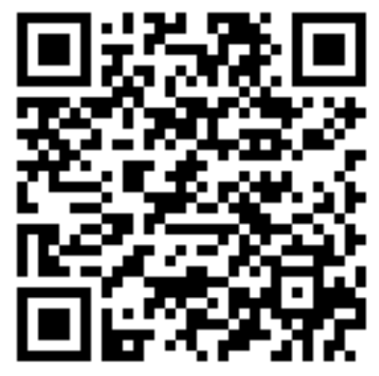
Broad 360
QR Code:

Slide 49
Thank you!

