Slide 1

Overview of Locality Tax Filing

Slide 2

Agenda
Intro to Local Income Tax Returns
Special Local Situations

Slide 3
Intro to Local Income Tax
2025-2026

Slide 4
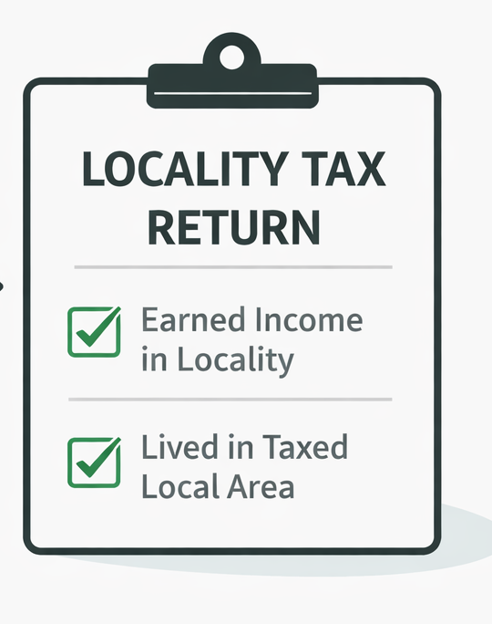
Who must file a local return?
A person must file a locality tax return if either one applies:
Lived in a taxing locality and earned income there
Worked in a taxing locality

Slide 5
What Income Gets Taxed?
Residents:
All salaries, wages, bonuses, commissions, and other compensation
Net profits from business or profession
Net rental income (out of scope)
Capital gains less any capital losses
Interest and dividends
Income from estates and trusts
Other income
Non-Residents:
Salaries, wages, bonuses, commissions, and other compensation for services rendered or work performed in city
Net rental income from property located in the city (out of scope)
Net profits from business, profession or other activity to the extent that it is from work done, services rendered, or activity conducted in the city
Capital gains less capital losses from the sale of real or tangible personal property located in the city only

Slide 6
Resident Vs. Non-Resident Returns
In Michigan localities, there are two types of local tax returns. The type of return determines the tax rate applied.
Non-Resident City Return
Resident City Return
Lived in a designated taxing locality
Worked in a taxing locality
Did not live in that locality during the time worked
Earned income from any source while living there

Slide 7
Localities We Primarily Serve
City of East Lansing
City of Lansing
Lansing Township
Meridian Charter Township (Okemos, Haslett)
Bath Township
The City of East Lansing and City of Lansing have a Local Income Tax of 1% for Residents, and 0.5% for Non-residents.

Slide 8
Michigan Cities with Income Tax
Be aware of MSU Students whose primary residence is located in any of these cities! You have to fill out a local return for these places as well.
Albion
Battle Creek
Benton Harbor
Big Rapids
Detroit
East Lansing
Flint
Grand Rapids
Grayling
Hamtramack
Highland Park
Hudson
Ionia
Jackson
Lansing
Lapeer
Muskegon
Muskegon Heights
Pontiac
Port Huron
Portland
Saginaw
Springfield
Walker

Slide 9
How to Confirm a Client's Locality
Sometimes, figuring out if a client lives in a taxing locality can be confusing. This commonly occurs for clients with a Lansing or East Lansing address, but homes reside in a non-taxing place like Lansing Township.
Use BS&A Online to confirm the client's locality.

Slide 10
Special Local Situations
2025-2026

Slide 11
Part-Year Residents
Part-year Residents are taxed at a prorated share of their income for the time they lived in jurisdiction subject to income tax.
Working From Home
Non-resident taxpayers who are 'working from home' need to calculate tax liability based on the amount of time worked in the non-resident city or risk overcalculating their tax liability
For non-residents, working from home means that those hours are not taxed by city
In both scenarios, the returns will be taxed at residency rates.

Slide 12
Dual Locality
  Sometimes, a taxpayer lives in a city with income tax and works in another city with income tax. (Example: Someone who lives in Lansing and works in East Lansing)
  If this is the case:
    Prepare the non-resident city return first – you cannot prepare multiple locality returns in TaxSlayer at the same time
    Then prepare the resident city return
    The resident city will credit the taxes paid to the non-resident city (since the nonresident city collects less than the amount the resident city collects)

Slide 13
Thank you!

