Slide 1

Advanced Certification Information

Slide 2

Agenda
Brokerage Statements (1099-B)
Health Savings Account (HSA)
Itemized Deductions
Schedule C
Estimated Payments

Slide 3
Schedule C
2025-2026

Slide 4
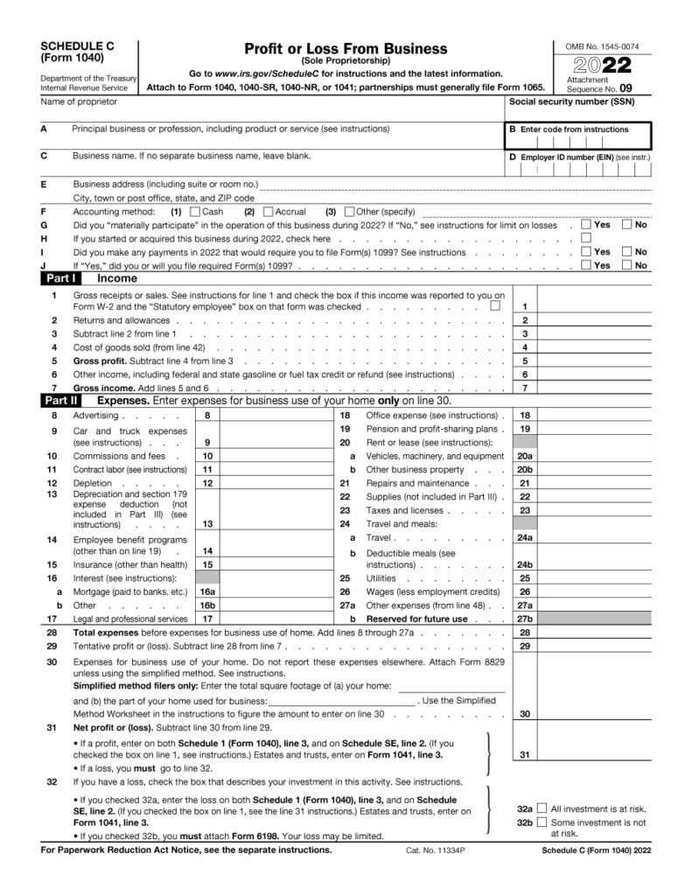
Schedule C – Profit or Loss from Business
Reports income and expenses from self-employed individuals (e.g. sole proprietors and single-member LLCs)
Schedule C Income is often reported on:
1099-NEC
1099-MISC
1099-K
Expenses
Must be “ordinary” and “necessary” in the course of business

Slide 5
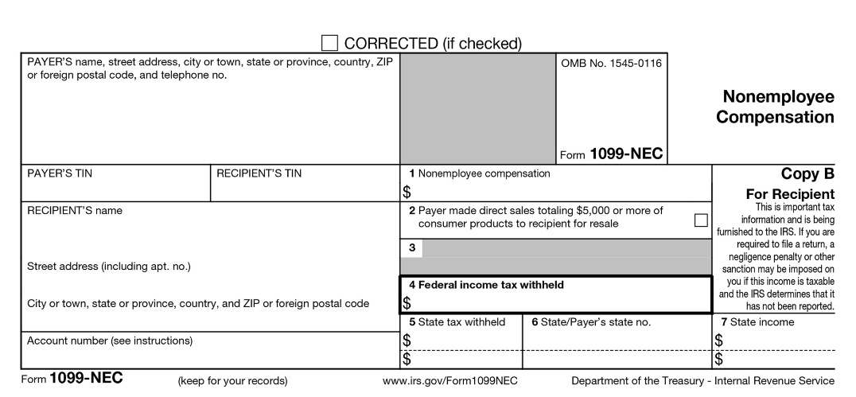
Form 1099-NEC (Non-employment compensation)
Reports payments made to nonemployees for services performed during the tax year
Issued to independent contractors, freelancers, or any non-employee individual or business who was paid >$600 for their services during the tax year
  At MSU VITA, we typically see a lot of clients who do Uber, Lyft, DoorDash, etc. on the side and they are classified as “independent contractors” because they are not direct employees of the company
  The food delivery & rideshare companies do not usually withhold taxes on behalf of the taxpayer

Slide 6
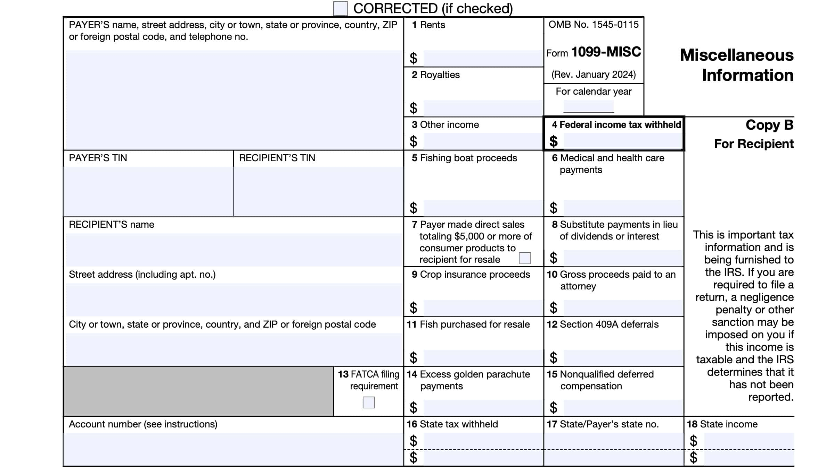
Form 1099-MISC (Miscellaneous Income)
Reports various types of income other than wages, salaries, tips, or non-employment compensation >$600
Common examples of income reported on a 1099-MISC form that you may encounter:
  Income from Prizes & Royalties
  Proceeds from Medical and Healthcare Services
  Lawsuit Payouts / Settlements
  Substitute Payments (in lieu of dividends or interest)

Slide 7
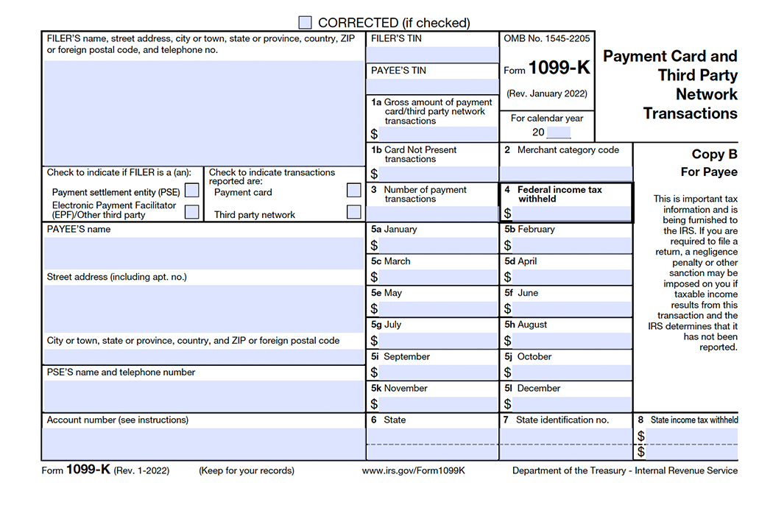
Form 1099-K (Payment Card and Third-Party Network Transactions)
Reports payments received through payment cards (like debit/credit cards) and third-party networks (Venmo, eBay, Etsy, Cash App, etc.)
Issued by payment processors (online POS systems like Square and Toast) and third-party networks
Reporting Thresholds for 1099-K:
  Any amount for credit/debit card transactions
  >$5,000 in total payments from third-party networks (IRS is looking to lower this threshold to $600)

Slide 8
Business Expenses
According to IRC § 162, to be deductible, business expenses must be:
  Ordinary – normal, usual, or customer under regular business circumstances. Specific to the current tax year.
  Necessary – an expense a ‘reasonable’ and ‘prudent’ businessperson would incur. In other words, is there a profit motive?
  The expense must be directly related to the business activity

Slide 9
Examples of Fully-Deductible Business Expenses
Most of these are generally considered out-of-scope for the VITA Program
Supplies Used/Consumed in the Business
Legal & Professional Services
Advertising
Business Insurance
Commissions & Fees to credit card companies, payment processors
Routine Repairs & Maintenance

Slide 10
Partially-Deductible Business Expenses You May Encounter
Business-related Meals
  Food purchased during business travel or with clients
  50% deductible
Mileage
  Use the standard mileage rate – for 2025 it is 70¢ per mile
  Only mileage for business use is deductible (this does not include commuting)
Utilities
  Only the % for business-use is deductible
Major Repairs & Maintenance
  Large expenditure that extends the useful life of the asset (e.g., an engine overhaul)
  Must not be in the ordinary course of business
  Taxpayers can capitalize and use §179 or Bonus Depreciation if >$2,500

Slide 11
Qualified Business Income (QBI) Deduction
Description:
Allows taxpayers with qualified business income to deduct 20% of business income. This also applies to independent contractors.
Documentation Needed:
-Business Income as reported on Schedule C
Income Range / Phase-Out:
Single, HOH, MFS
- Phase Out $197,300 -$247,300
MFJ/QSS
- Phase Out $394,600-$494,600

Slide 12
Other Advanced Topics
2025-2026

Slide 13
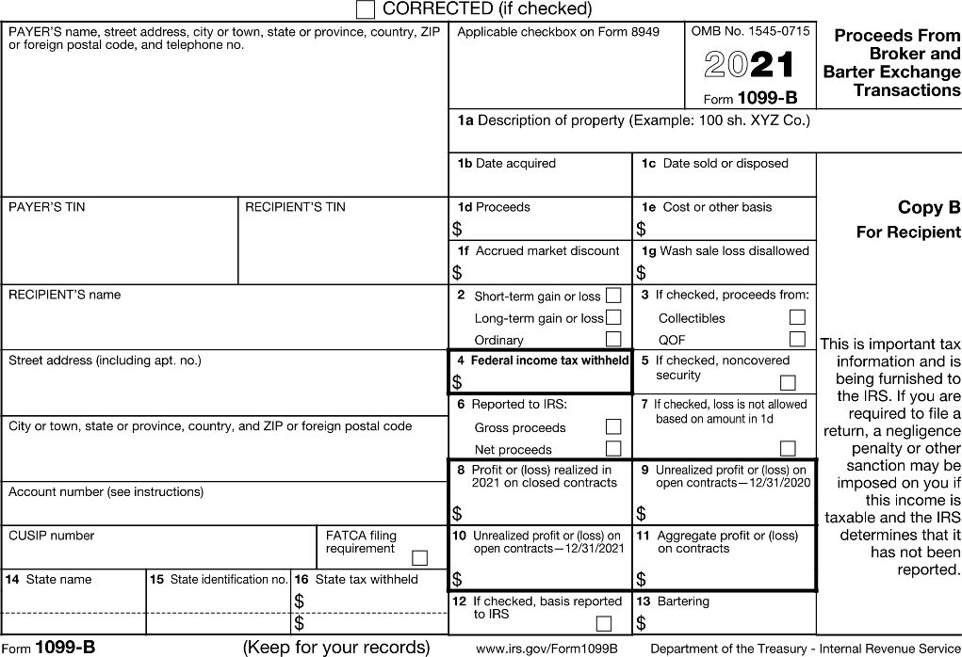
Form 1099-B (Proceeds from Broker and Barter Exchange Transactions)
Reports the sale or exchange of investment assets (stocks, bonds, mutual funds, ETFs, etc.) to taxpayers and the IRS
  Remember that the sale or exchange of crypto is not within scope for VITA
Reported by brokerage firms and financial institutions (Fidelity, Schwab, Robinhood, etc.)
Determines capital gains or losses reported on Form 8949 → carried over to Schedule D
Will sometimes be a part of a consolidated brokerage statement

Slide 14
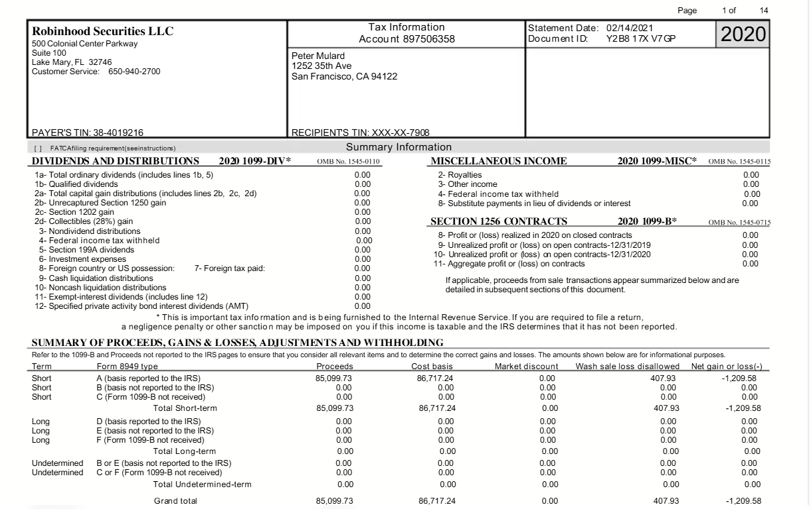
Consolidated Brokerage Statement Example
Sometimes, instead of providing individual tax forms, investment firms will provide a consolidated brokerage statements, which summarizes all necessary tax information.
Forms 1099-DIV and 1099-MISC typically included in consolidated brokerage statement with 1099-B.
Summary of Proceeds, Gains & Losses is the information that you will enter into TaxSlayer for Form 1099-B.

Slide 15
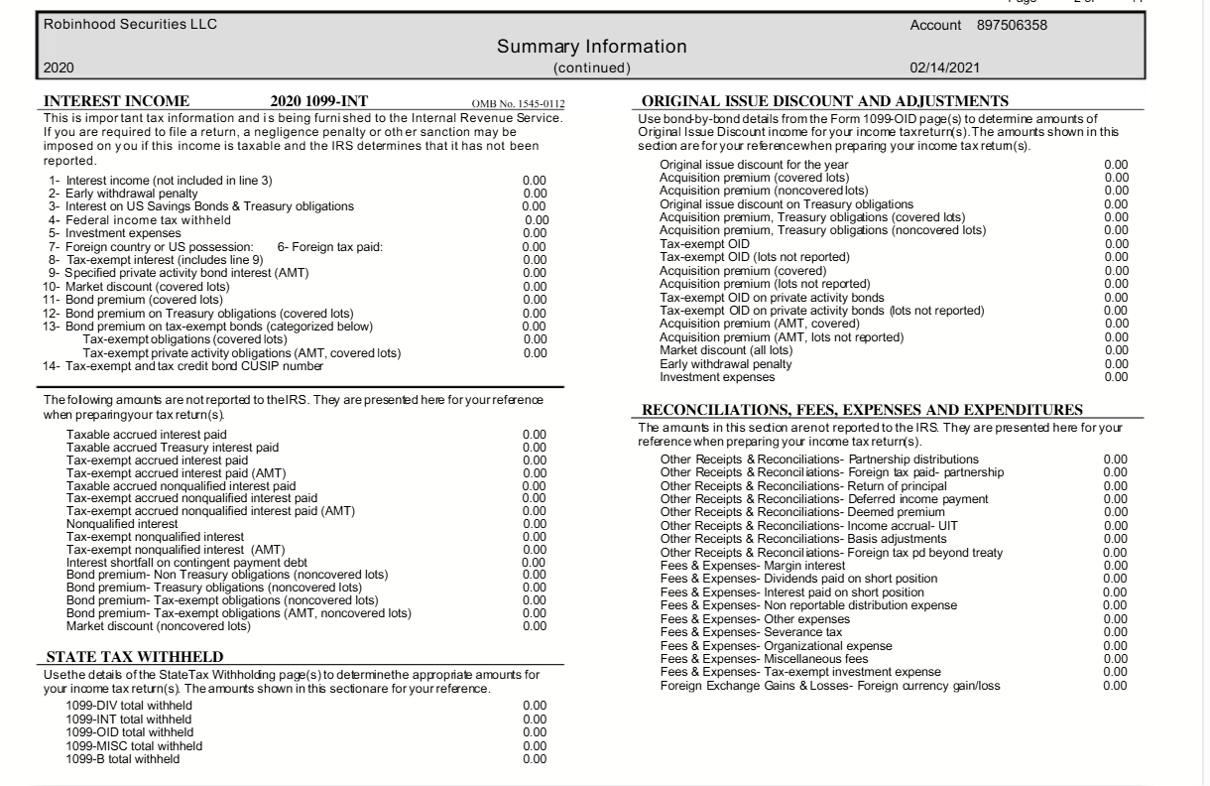
Consolidated Brokerage Statement Example
1099-INT statements are also typically included in consolidated brokerage statements.

Slide 16
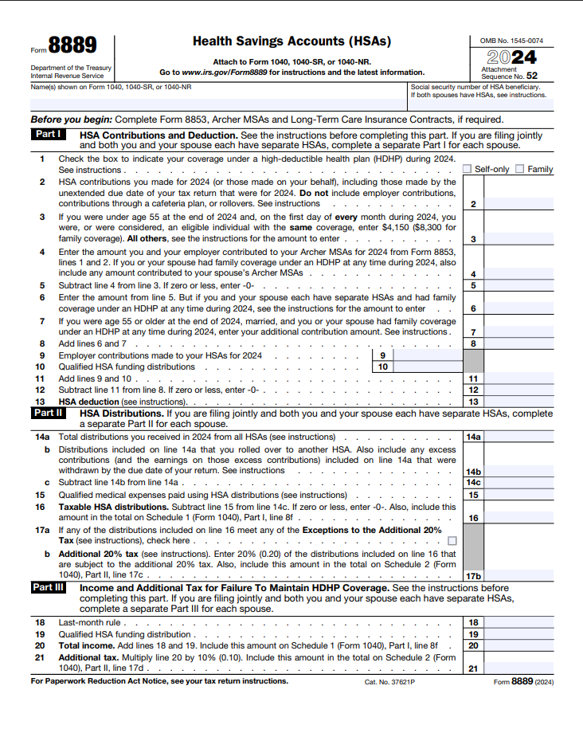
Health Savings Account (HSA)
An HSA is a tax-advantaged savings account used to pay for qualified medical expenses (QME). It’s available only to individuals covered by a High-Deductible Health Plan.
Contribution Benefits
Contributions are tax-deductible (above-line-deduction).
Gains & distributions used for (QME) are tax-free.
Distributions not used for QME are:
Taxable as regular income
Penalized an extra 20% (unless age 65+, disabled, or deceased)
2 Ways to contribute
Personally (fund account directly with after tax dollars)
  Must claim HSA deduction on Tax return to receive the benefit
Through Company Payroll deductions
  Benefits already received (Income already reduced on W-2)

Slide 17
Health Savings Account (HSA)
2025 HSA contribution limits/ Max Deduction
 | Single Plan | Family Plan
Maximum Contributions | $4,300 | $8,550
55+ Catch up Bonus | +$1,000 | +$1,000 per eligible spouse
HSA Eligibility
Single plans:
Deductible Minimum: $1,650
Out-of-Pocket Maximum: $8,300
Family plans:
Deductible Minimum: $3,300
Out-of-Pocket Maximum: $16,600

Slide 18
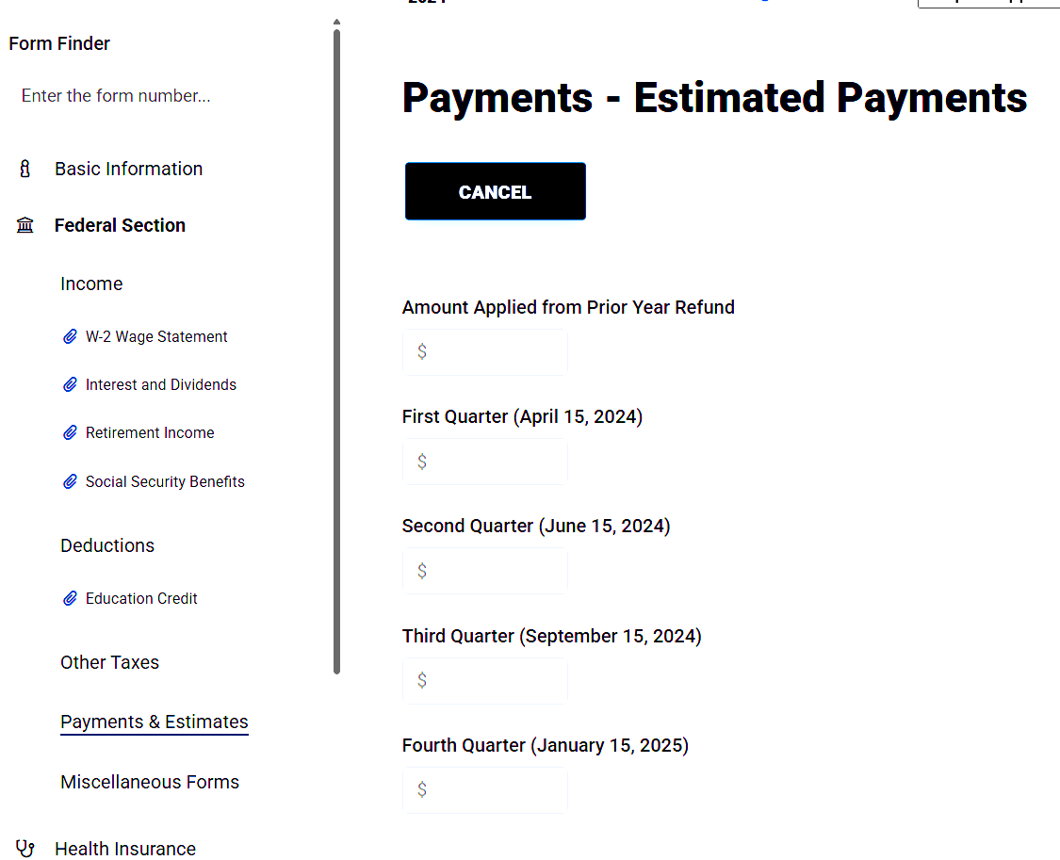
Clients Who Made Estimated Payments
Estimated tax payments are amounts individuals send directly to the IRS to cover self-employment, federal income, and other taxes.
Clients with self-employment income (Forms 1099-NEC, 1099-MISC, or Schedule C) should generally make these payments.
The IRS requires four quarterly installments, though some clients may pay irregularly.
Documentation needed to report this in TaxSlayer:
Proof of receipt or payment
If missing, have the client check this amount on their IRS online account
How to add in TaxSlayer Pro:
Federal --> Payments & Estimates --> Input

Slide 19
Itemized Deductions
2025-2026

Slide 20
State & Local Taxes (SALT)
Description:
Allows taxpayers who itemize to deduct certain state and local taxes - such as income, property, and sales taxes paid during the year.
Amount:
Up to $40,000 (Sing/MFJ/HOH/QSS)
$20,000 if (MFS)
Phased out:
All taxpayers with MAGI over $500,000
$250,000 if (MFS)
Filing Status Qualified:
All filing statuses qualify if itemizing deductions.
Qualifications:
• Must itemize deductions on Schedule A.
Deductible taxes included in (SALT)
• State Taxes withheld from W-2
• Local Taxes Withheld from
• Estimated Payments made to State & Localities
• Real estate tax
• Certain Personal Property
- State and Local Fees/Taxes that are paid:
(based on the properties value or imposed annually)
• Not available for taxes paid on business or rental property (deducted elsewhere).
Documentation Needed:
– Form 1098 (for property tax if escrowed)
– State/local tax statements or receipts
– W-2s showing state/local income tax withheld

Slide 21
Charitable Donations
Description:
Allows taxpayers to deduct donations made to qualified charitable organizations. Donations must be made within the tax year and may include cash or property.
Limitations
Cash donations: You can deduct cash gifts to public charities up to 60% of your AGI.
Property donations: Non-cash gifts like appreciated stock (held over one year) are limited to 30% of your AGI.
Donations Requirements:
$250 or more to single charity: Written acknowledgment from the charity required.
Cash donations: Receipt or bank record required
for all amounts.
Non-cash property: Appraisal required if value
over $5,000 (or $10,000 for closely held stock).
Qualified Organizations:
• federal, state, or local governments (for public purposes)
• 501(c)(3) charities, religious, educational, scientific, literary organizations
• Churches and religious groups
• War veterans’ organizations
• Nonprofit volunteer fire departments
• Civil defense organizations
• Domestic fraternal societies (for charitable use only)
Documentation Needed: Receipts or written acknowledgments for all donations. For non-cash property: appraisal or valuation records (Pub. 561). Substantiation and disclosure requirements (Pub. 1771).

Slide 22
Medical & Dental Expense
Description:
Allows taxpayers who itemize to deduct qualified
medical and dental expenses (QME) that exceed a set percentage of their Adjusted Gross Income (AGI) for the year.
Amount: Can only deduct the portion of total qualified medical expenses that exceeds 7.5% of AGI.
Does not Qualify:
Cosmetic surgery, over-the-counter medications
(unless prescribed), and general health items (like vitamins).
Documentation Needed:
– Receipts, invoices, or canceled checks for medical expenses
– Explanation of Benefits (EOB) from insurance providers
– Records of travel/mileage for medical purposes
Qualifications:
• Must itemize deductions on Schedule A.
• Expenses must be primarily for the diagnosis, cure, mitigation, treatment, or prevention of disease.
• Medical expenses can be for the taxpayer, spouse, or dependents.
• Insurance premiums, prescription drugs, long-term care, and certain travel expenses for medical care may qualify.
Examples of Deductible Medical Expenses:
• Doctor, dentist, and hospital fees
• Prescription medications
• Medical insurance premiums (if paid with after-tax dollars)
• Long-term care expenses
• Mileage or transportation costs for medical visits

Slide 23
Mortgage Interest Deduction
Description:
Allows taxpayers who itemize to deduct interest paid on a qualified home loan, such as a mortgage on a primary or secondary residence.
Amount:
• Deduct interest paid on up to $750,000 of qualified home acquisition debt ($375,000 if MFS).
• For older loans (before Dec. 15, 2017), the limit increases to $1,000,000 ($500,000 if MFS).
Filing Status Qualified:
All filing statuses qualify
Qualifications:
• Must itemize deductions on Schedule A.
• Loan must be secured by a qualified residence (main home or one second home).
• Mortgage proceeds must be used to buy, build, or substantially improve the home securing the loan.
• Home equity loan interest is deductible only if funds are used for home improvements.
• Interest on rental or business property is not deducted here (reported elsewhere).
Documentation Needed:
– Form 1098 (Mortgage Interest Statement) from the lender
– Loan and settlement statements showing loan purpose and use
– Records of any home improvements financed by the loan

Slide 24
What's ahead?
What's ahead?
Exam Review
  This session will take place during the final week of classes, so you can take the exams over the holiday break if you would like
State and Local Taxes
  When we return in January

Slide 25
Thank you!

