Slide 1

Overview of Federal Tax Concepts

Slide 2

Unearned income
*DISCLAIMER*
This presentation covers a wide range of information. We’ll focus on the most important topics today, and a copy will be shared afterward for your reference.

Slide 3
Agenda
Gross Income (earned/unearned)
Adjustments
Deductions
Federal Credits
FICA Tax

Slide 4
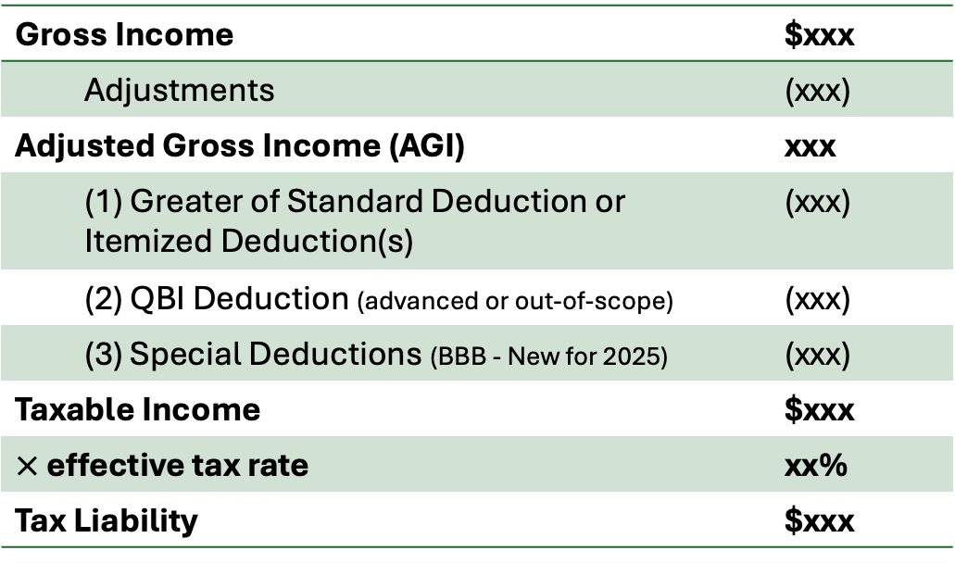
Simplified Representation of the Income Tax Process
Gross Income | $xxx
Adjustments | (xxx)
Adjusted Gross Income (AGI) | xxx
(1) Greater of Standard Deduction or Itemized Deduction(s) | (xxx)
(2) QBI Deduction (advanced or out-of-scope) | (xxx)
(3) Special Deductions (BBB - New for 2025) | (xxx)
Taxable Income | $xxx
$×$ effective tax rate | xx%
Tax Liability | $xxx
Tax Liability | $xxx
Less: Tax Credits | (xxx)
Less: Prepayments/Withholdings | (xxx)
Taxes Owed (Refund) | xxx

Slide 5
Overview of Gross Income
(Earned/Unearned)
2025-2026

Slide 6

Earned income
Earned income - money you receive from actively working, such as wages, salaries, tips, commissions, bonuses, or self-employment earnings.

Slide 7
Earned income
Tax Forms organized by importance:
W-2
1099-NEC
1099-MISC (Depends)
Schedule C
K-1
Wages/Salaries
Self-employment or Business Income
Commission/Tips
Bonuses
Disability/Strike Income

Slide 8
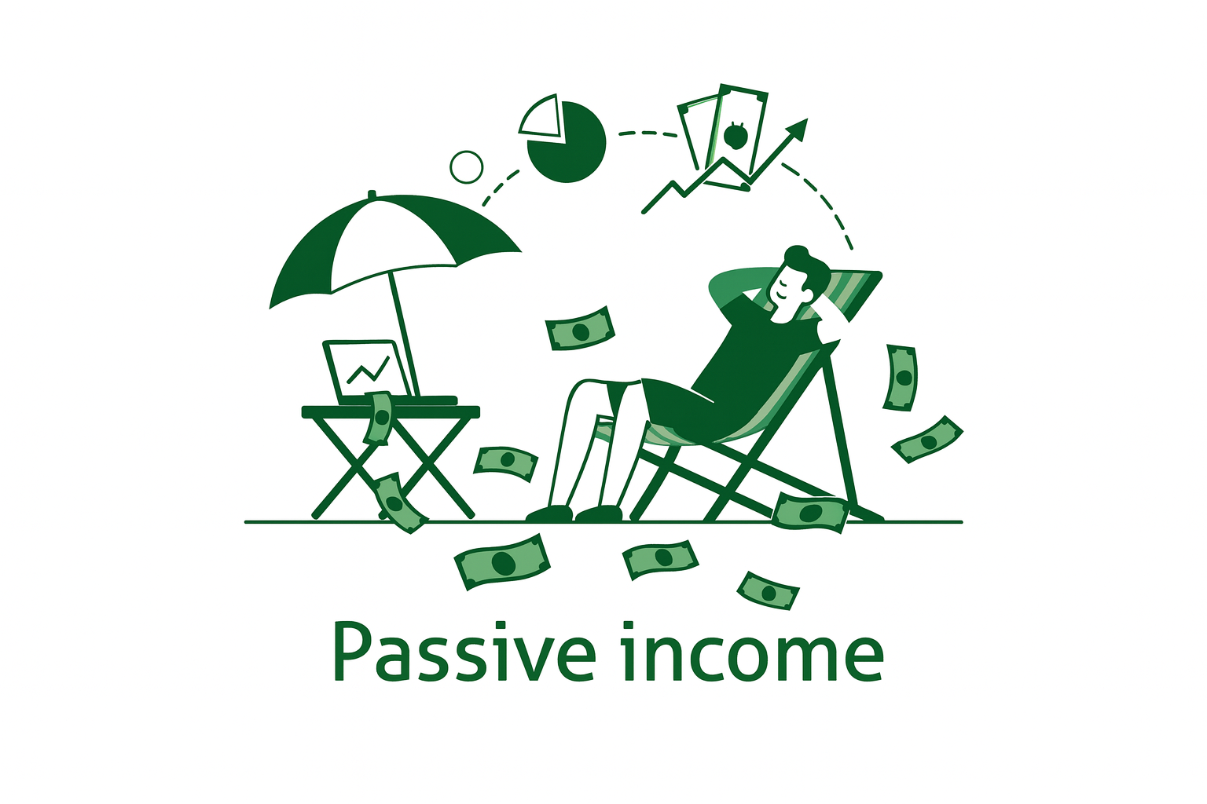
Unearned income
Unearned income - money you receive that isn’t from active work, such as investments, rental income, or Social Security benefits.

Slide 9
Unearned income
Tax Forms organized by importance:
W-2
1099-INT
1099-DIV
1099-B
1099-R
1099-SSA
1099-MISC (Depends)
Schedule E
K-1 (If the partner was not involved in the day-to-day operations of the partnership)
Interest
Capital Gains / Investment Sales
Dividends
Taxable Scholarships
Rental Income
Retirement Income / Pensions
Social Security / SSDI Benefits)

Slide 10
FICA Tax
2025-2026

Slide 11
FICA Tax
(Federal Insurance Contributions Act)
FICA Tax - automatically withheld from W-2 wages to fund: Social Security (retirement and disability benefits) & Medicare (healthcare for seniors).
- In other words, FICA is a Tax on your gross earned income
Limitations:
Social Security: Applies only to the first $176,000 of earned income.
Medicare: Applies to all earned income. High-income earners pay an additional 0.9% Medicare surtax.
Self-employment tax - applies only to self-employment income (relevant to gig workers such as Uber Drivers...) It replaces FICA for self-employed individuals and is calculated at the same 15.3% rate on 92.35% of net business income.
FICA Tax 15.3% (7.65% Employee)
Social Security 12.4%
Medicare 2.9%
Employee 6.2%
Employer 6.2%
Employee 1.45%
Employer 1.45%

Slide 12
Adjustments & Deductions
2025-2026

Slide 13
Adjustments & Deductions
Clarification
Adjustments
Standard Deduction
Itemized Deduction
For AGI
Both adjustments and deductions reduce taxable income and are referred to as “deductions” in the tax code - they just occur at different stages.
Above-the-line: (Adjustments): Reduces gross income to calculate AGI.
Below-the-line: (Deductions): Reduces AGI to arrive at Taxable income.

Slide 14
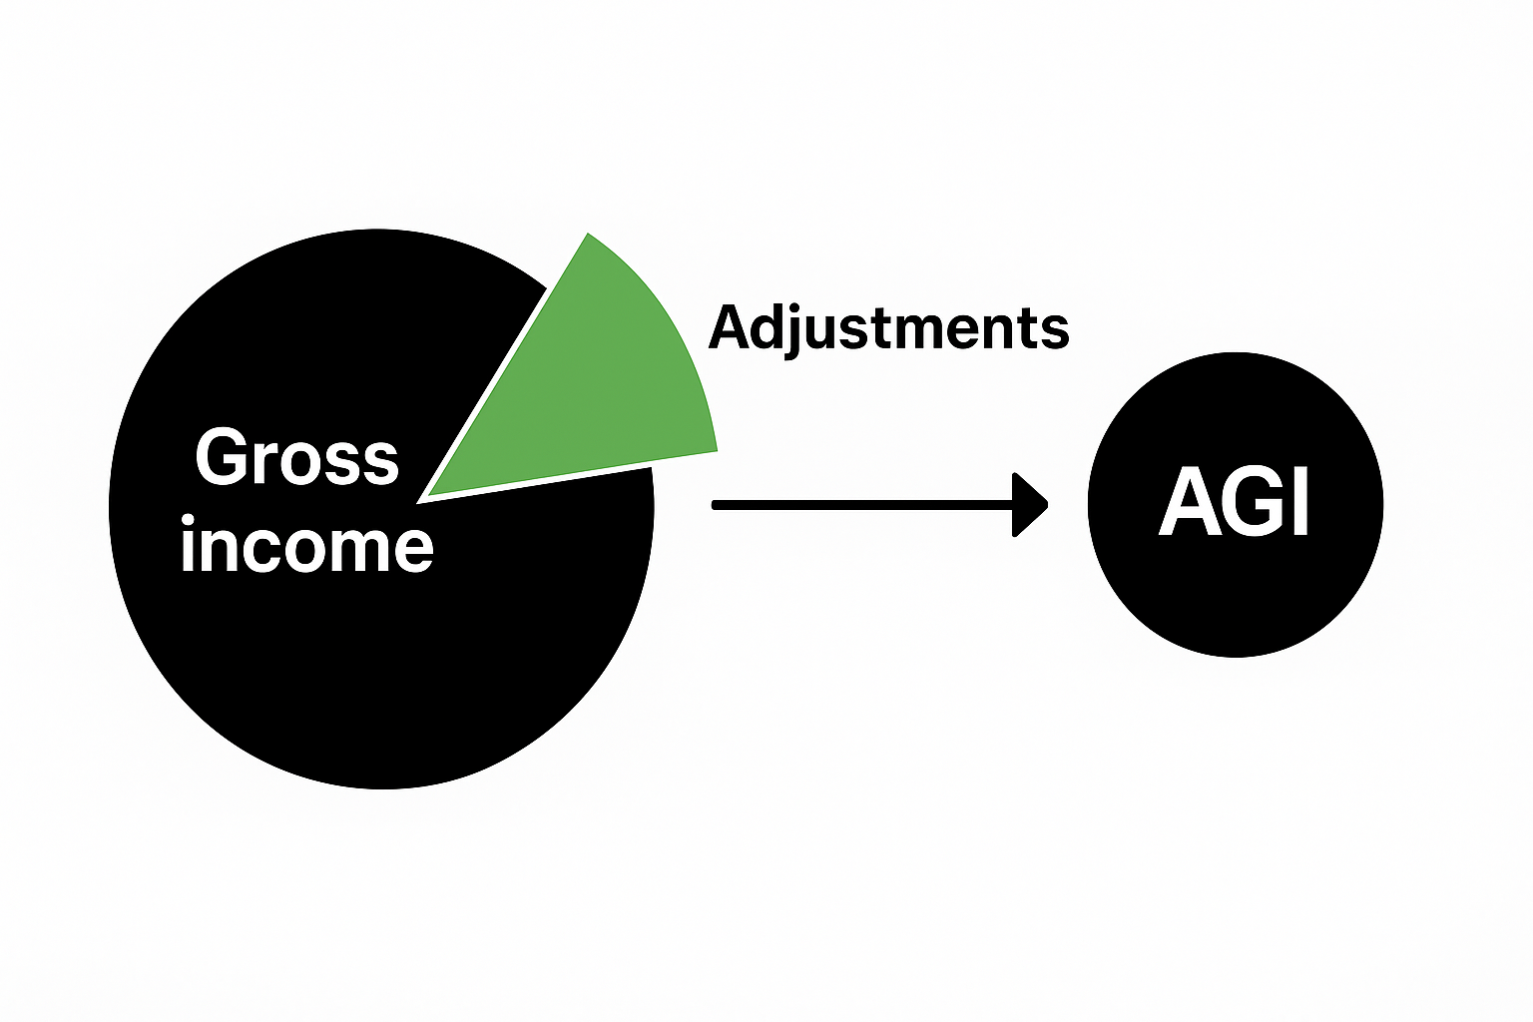
Adjustments
(above-the-line deduction)
Deductions applied to your gross income that reduce your taxable income. These typically include qualified expenses or contributions that the IRS allows you to deduct when calculating your Adjusted Gross Income (AGI).

Slide 15
Most Common Adjustments You Might Encounter
Student loan interest deduction
Traditional IRA contributions
Educator expenses
Half of self-employment tax

Slide 16

Student Loan Interest Deduction
Description: lets eligible taxpayers deduct interest paid on qualified student loans
Amount: Deduct up to $2500
Filing Status qualified:
Sing/QSS/HOH
- Full ≤ $85k | Phase Out $85–100k
MFJ
- Full ≤ $170k | Phase Out $170–200k
Qualifications:
Loan must be a federal or state-held student loan.
Loan attributed to you, your spouse, or a dependent
MAGI must be below the IRS phase-out threshold for the year.
Documentation Needed: 1098-E
"student loan interest statement"
- Not Strictly Required
- Provided if $600>

Slide 17
Qualified Educator Expenses
Educator Expense Description:
Lets eligible teachers and certain school staff deduct unreimbursed classroom expenses.
Amount: Deduct up to $300 per eligible
educator
Filing Status qualified:
Sing/QSS/HOH
- Up to $300
MFJ
- Up to $600 (if both spouses qualify)
Qualifications:
• Must be a K–12 teacher, instructor, counselor, principal, or aide, OBBA: *interscholastic sports administrators or coaches*
• Must work at least 900 hours in a school providing elementary or secondary education.
• Expenses must be unreimbursed and ordinary classroom costs (e.g., supplies, books, tech, PPE, professional development).
Documentation Needed: Receipts or proof of payment
– Not required to attach to return
– Keep records for verification if audited

Slide 18
Traditional IRA
Contribution
Description:
Lets eligible taxpayers deduct contributions made to
a Traditional IRA, reducing taxable income for the year.
Amount: Deduct up to $7,000 (or $8,000 if age 50 or older). “Per individual”
Filing Status qualified:
Sing/QSS/HOH
- Full if MAGI ≤ $79k | Phase Out $79–89k
MFJ
Full if MAGI ≤ $126k | Phase Out $126–146k
MFS
- Partial if MAGI < $10k
Qualifications:
• Must have earned income (wages or self-employment).
• Contributions must be made by the tax-filing deadline (generally April 15, 2026 for 2025 returns).
• Deduction may be limited if you or your spouse are covered by a retirement plan at work.
• Must be under age 70½ at the end of the tax year.
Documentation Needed:
Form 5498 – IRA Contribution Information
Form W-2 / pay stub – to verify earned income
– Contributions reported to IRS by financial institution
– Keep records of contribution date and amount

Slide 19
Traditional IRA vs Roth IRA
Don’t get these confused – they are very similar!
Roth IRA
Traditional IRA
Taxpayer contributes funds before taxes and pays the taxes when they withdrawal funds (take distributions) from the account
Taxpayer contributes funds after taxes but future withdrawals are tax-free
Contributions are NOT tax deductible

Slide 20
Half of Self Employment
Tax
Self-Employment Tax Deduction
Description:
Lets self-employed individuals deduct 50% of the self employment tax they pay, representing the employer-equivalent share of Social Security and Medicare taxes.
Amount: Deduct 50% of total self-employment tax paid on net earnings from self-employment.
Filing Status qualified:
All filing statuses qualify - deduction amount based on income, not status.
Qualifications:
• Must have net earnings from self-employment of $400 or more.
• Reduces adjusted gross income (AGI) but not net earnings for Social Security purposes.
• Applies to sole proprietors, independent contractors, and partners in a partnership.
Documentation Needed:
- Schedule SE (Form 1040) – to compute self-employment tax,
- Schedule C (Form 1040) – to report business income and expenses
– Keep proof of income and expense records for verification

Slide 21
Standard Deduction
2025-2026

Slide 22
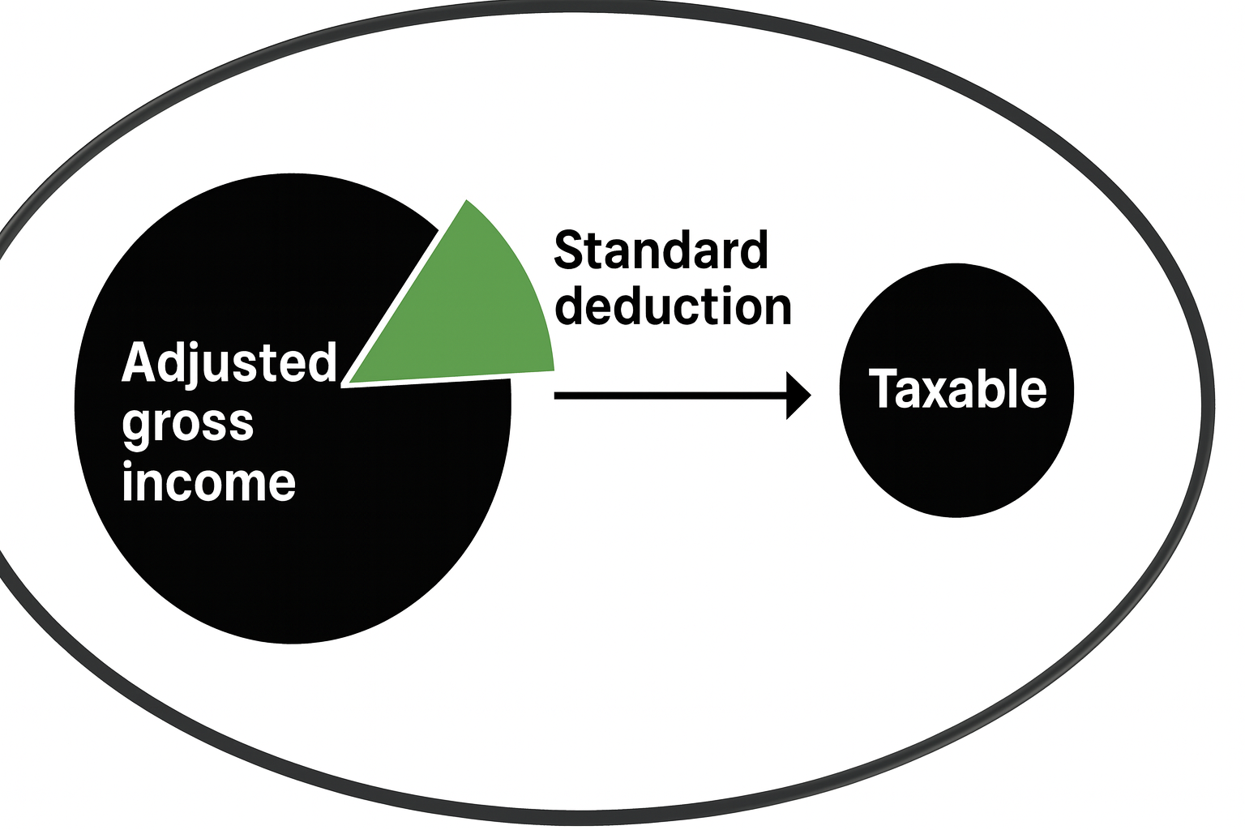
Standard Deduction
(below-the-line deduction)
Standard Deduction – a fixed dollar amount that reduces the income you’re taxed on. It’s available to all taxpayers who don’t itemize and helps simplify the filing process while lowering overall taxable income.

Slide 23



Standard Deduction
INFO | Single/MFS | HOH | MFJ/QSS
Standard Deduction | $15,750 | $23,625 | $31,500
+65 or Blind Per Individual *Amount doubles if both conditions apply | $2,000/$1,600 | $2,000 | $1,600

Slide 24
Itemized Deductions
2025-2026

Slide 25
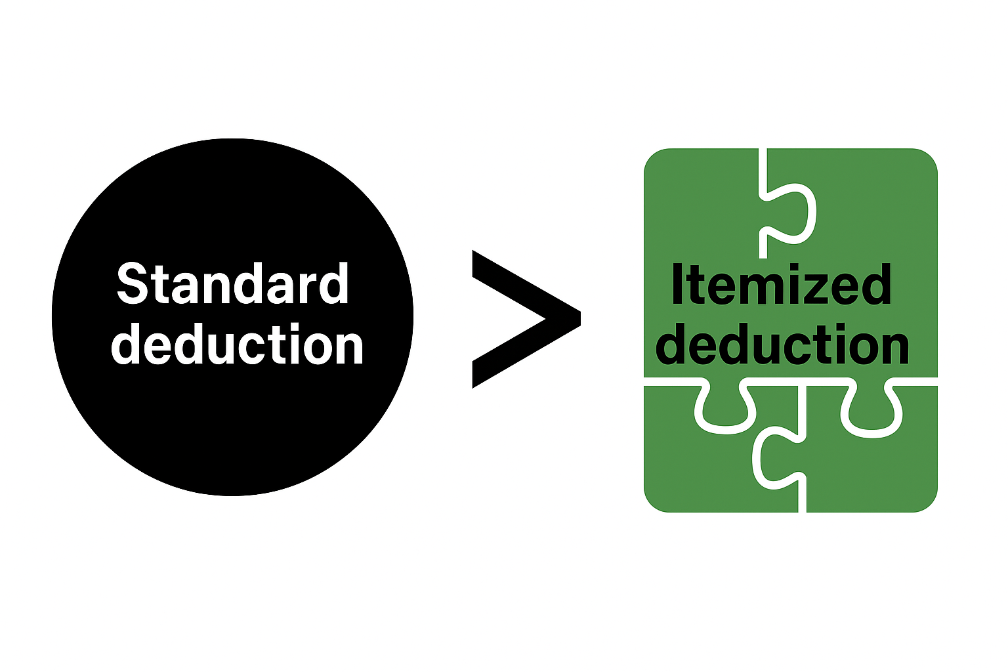
Itemized Deduction
(below-the-line deduction)
Itemized Deduction – Itemized deductions are specific expenses: like mortgage interest, state and local taxes, and medical bills, that you can subtract from your income instead of taking the standard deduction.
You should only itemize if the sum of these deductions is greater than the standard deduction
Made up of several individual deductions that are added together

Slide 26
Most Common Itemized Deductions
Medical and Expense Deduction
Property Taxes
SALT Deduction
Mortgage Interest Deduction
Charitable Donations
Casualty Loss

Slide 27
Other Deductions
2025-2026

Slide 28
No Tax on Tips
(BBB)
Description:
Allows certain taxpayers to exclude qualified tip income from taxation under special IRS provisions. (Only applies in limited cases, such as tip income covered
by specific tax-free programs or exceptions.)
Amount:
Maximum deduction of $25,000.
Filing Status qualified:
Sing/QSS/HOH/ MFJ
Documentation Needed:
-W-2
-Personal tip records
Income Range / Phase-Out:
Sing/QSS/HOH
- Full <= $150k | Phase Out > $150k
MFJ
- Full <= $300k | Phase Out > $300k
Qualifications:
• Applies only to qualified tax-exempt tips, such as those received through designated training or research programs.
• Cash and noncash tips from regular employment.
• Tips not exceeding reporting thresholds may still require inclusion in total wages.
• Employees must report tips of $20 or more per month to their employer.

Slide 29
No Tax on Overtime
(BBB)
Description: Let's taxpayers deduct the FLSA
required overtime premium (the “half” portion above the regular rate in time-and-a-half) that is reported on a ‘W-2, 1099, or other specified statement.’)
Filing Status qualified:
Sing/HOH/QSS - Up to $12,500
MFJ - Up to $25,000
- For every $1,000 over MAGI limit, deduction is reduced by $100.
- Starting in 2025, employers must separately report overtime pay. Will temporarily show this on Box 14 (Overtime) or a separate statement until Form W-2 adds a dedicated overtime box.
Income Range / Phase-Out:
Sing/QSS/HOH
- Full <= $150k | Phase Out > $150k
MFJ
- Full <= $300k | Phase Out > $300k
Qualifications:
• Overtime must be the premium portion required by FLSA (amount above regular rate).
• Amount must be reported by the payor on W-2/1099/other specified statement.
• Valid SSN
Documentation Needed:
• W-2 / 1099 (or specified statement) showing total qualified overtime compensation

Slide 30
Car Loan Interest Deduction
(BBB)
Description: Let's eligible taxpayers deduct interest paid on a qualified car loan used to purchase a new, personal-use vehicle. Applies to vehicles purchased after Dec. 31, 2024 and available 2025 – 2028.
Amount: Deduct up to $10,000 of qualified interest per year. If MFJ can deduct up to $20,000.
Income Range / Phase-Out:
Sing/QSS/HOH/MFS
- Full <= $100k | Phase Out > $100k
MFJ
Full <= $200k | Phase Out > $200k
Qualifications:
• Loan must be secured by the vehicle and originated after 12/31/2024.
• Vehicle must be for personal use, not business or commercial.
• Vehicle must undergo final assembly in the U.S. (verify via VIN label or NHTSA VIN Decoder).
• VIN must be reported on the tax return when claiming the deduction.
Documentation Needed:
- Loan statement showing total interest paid
- Vehicle VIN – entered on tax return

Slide 31
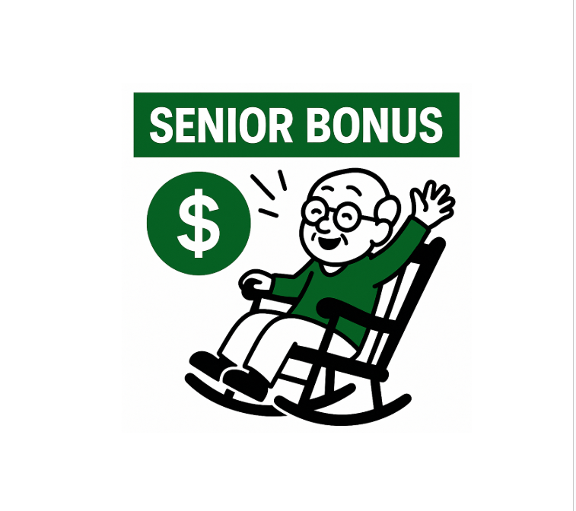
Bonus Deduction for Seniors
(below-the-line deduction) (BBB)
Description: Allows eligible taxpayers aged 65 or older to claim an additional deduction of $6,000 per qualifying individual, regardless of if the taxpayer itemizes or takes the standard deduction. This deduction is added on top of the standard senior/ blind standard deduction increase.
Amount: $6,000 per eligible individual
Filing Status:
Single / HOH / QSS: Up to $6,000
MFJ: Up to $12,000 (combined)
Income Range / Phase-Out:
Full if MAGI ≤ $75k | Phase Out $75-175k (Sing/HOH/QSS)
Full if MAGI ≤ $150k | Phase Out $150-250k (MFJ)

Slide 32
Credits
2025-2026

Slide 33
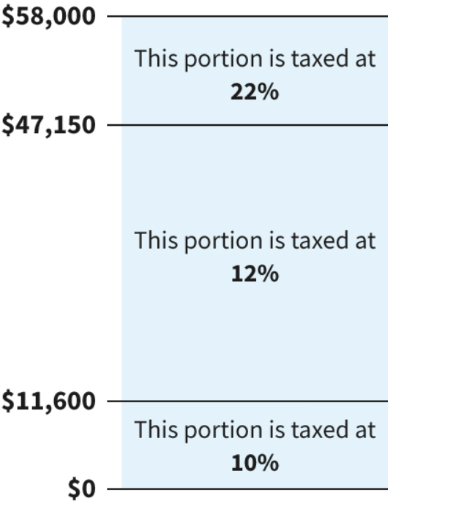
Taxable Income → Tax Credits
Tax
Liability
Taxable
Income
Effective Tax Rate
Don’t worry, the software calculates this!

Slide 34
Taxable Income → Tax Credits
Tax
Liability
Total Tax
Refund/ Amount
Owed
Tax
Credits
Tax
Prepayments/Witholdings
FINAL CALCULATION!

Slide 35
Most Common Tax Credits You Might Encounter
American Opportunity Tax Credit
Child Tax Credit
Earned Income Tax Credit
Lifetime Learning Credit
Premium Tax Credit
Savers Credit
Child and Dependent Care Credit

Slide 36
American Opportunity Tax Credit (AOTC)
Description:
Provides students (or parents) with a tax credit for qualified education expenses paid for the first four years of postsecondary education. This credit applies to tuition, fees, and required course materials for students.
Refundability: Up to 40% (Max: $1,000) of the credit may be refundable
Amount/Calculation:
Maximum annual credit of $2,500 per student.
• 100% of the first $2,000 of qualified expenses
• 25% of the next $2,000 of qualified expenses
• Up to 40% ($1,000) of the credit may be refundable.
Filing Status Qualified:
Single/HOH/QSS Phase Out: $80,000 - $90,000
MFJ Phase Out: $160,000 - $180,000
Qualifications:
• Student must be enrolled at least half-time in a program leading to a degree or recognized credential.
• Credit available only for the first four tax years of postsecondary education.
• No felony drug conviction at the end of the tax year.
• Qualified expenses include tuition, fees, and required course materials (not room or board).
Documentation Needed:
• Form 1098-T from the educational institution
Records of tuition and fees paid
• Proof of course materials purchased (books, supplies, etc.)

Slide 37
Lifetime Learning Credit (LLC)
Description:
Provides taxpayers with credit for qualified tuition and related expenses paid for eligible students enrolled in Unlike the American Opportunity Credit, the Lifetime Learning Credit is available for ALL years of postsecondary education and for courses.
Refundability: Nonrefundable
Amount / Calculation:
• Maximum annual credit of up to $2,000 per tax return (not per student).
• Equal to 20% of up to $10,000 in qualified education expenses paid.
Filing Status Qualified:
Single/HOH/QSS Phase-Out: $80,000 – $90,000
MFJ Phase-Out: $160,000 – $180,000
Qualifications:
• Student must be enrolled in at least one course at an eligible educational institution.
• Credit is available for any number of years - no limit based on number of years claimed.
• Qualified expenses include tuition and required fees (not room, board, insurance, or transportation).
Documentation Needed:
• Form 1098-T from the educational institution • Receipts or records of tuition and eligible fees paid

Slide 38

Quick Break From Taxes - Obamacare
Obamacare (Affordable Care Act) – A federal law that expanded access to affordable health care.
Created the Health Insurance Marketplace where people can shop for and subsidized health plans
Expanded Medicaid eligibility in many states to cover more low-income adults
Provides financial help to lower premiums and out-of-pocket costs
Requires coverage for essential benefits and pre-existing conditions
Sends Form 1095-A if you had Marketplace coverage to report on your tax return

Slide 39
Quick overview of U.S. Healthcare plans
Provided by Government,
Must apply/enroll to receive
Medicaid
Marketplace
(ACA)
Private Healthcare Insurance
Medicare
Purchased by Individual
PHI -"also provided by your employer"

Slide 40
Overview of U.S. Healthcare Plans
Aka Obamacare
Medicaid
Marketplace
(ACA)
Private Healthcare Insurance
Medicare
State-run health coverage for low-income individuals and families (funded jointly by state and federal government). Expanded under the Affordable Care Act.
*Partially Defunded by
BBB 2025
Health insurance bought directly by individuals through the federal or state Marketplace who don’t qualify for Medicaid. (Provide subsidized coverage and tax credits, PTC)
*Partially Defunded by
BBB 2025
Health insurance bought directly from the Healthcare providers/ or provided by company's to their employes
Federal health coverage for individuals age 65+ and certain younger people with disabilities.

Slide 41
Premium Tax Credit (Form 1095-A)
Description: credit to help eligible taxpayers pay for health insurance purchased through the Marketplace, reducing monthly premium costs based on household income.
(BBB Changes): For the current tax season, clients can still claim the enhanced Advanced Premium Tax Credit, despite its expiration at the end of 2025.
Refundability: Refundable
Amount / Calculation:
Form 1095-A lists the Marketplace premiums and advance payments. Once entered, the software automatically calculates the Premium Tax Credit volunteers just need to ensure the 1095-A is accurate.
Filing Status Qualified:
Single / HOH / QSS: Income between 100%–400% of Federal Poverty Line (FPL).
MFJ: Income between 100%–400%
Qualifications:
• Must have purchased coverage through the Health Insurance Marketplace (Exchange).
• Cannot be eligible for other medical coverage
• Must not be claimed as a dependent by another taxpayer.
Documentation Needed:
• Form 1095-A (Health Insurance Marketplace Statement)

Slide 42
Earned Income Tax Credit
Qualifications:
• Must have earned income (wages, SE income)
• Must be at least 25 years old but under 65 to qualify for EITC
• Valid SSN, (any Taxpayer or Dependent with ITIN’s will not qualify for this credit)
• Cannot be claimed as a dependent on tax return
• Investment income ≤ $11,600 (2025)
• QCs must meet relationship, age, residency, and joint return tests
• Married taxpayers filing separately can qualify for the EITC only in specific circumstances outlined by the IRS
Description: Tax credit for low-moderate income workers that reduces their tax burden. Amount depends on income, filing status, and # of qualifying children (QC).
EITC Calculation

Slide 43
Child Tax Credit
Description:
Provides a credit for each qualifying child under age 17 with a valid SSN. Designed to reduce
federal income tax and, in some cases, provide a partial refund.
Amount / Calculation:
• Up to $2,200 per qualifying child (QC) under age 17
Single/HOH/QSS - MAGI phases out >= $200,000
MFJ - MAGI phase out >= $400,000
MFS - Qualifies in certain circumstances
Refundability: Partially refundable
(up to $1,700 as the Additional Child Tax Credit, 2025).
Qualifications (must meet all):
• Child under age 17 at end of tax year
• Child must have a valid SSN issued by due date of return
• Lived with taxpayer over half the year
• Claimed as a dependent
(OBBB NEW CHANGES)
At least one taxpayer (if filing jointly) and the qualifying child must each have a valid Social Security Number that authorizes them to work in the United States.

Slide 44
Child and Dependent Care Credit
Description:
Offered to taxpayers who pay out of-pocket expenses for childcare. The credit provides relief
to individuals and spouses who pay for the care
of a qualifying child or disabled dependent while working or looking for work.
Amount / Calculation:
• The credit equals a percentage of work-related
expenses the taxpayer paid someone to care for their child or another qualifying person (ranges from 20-35% depending on income)
Qualifying Expenses:
Daycare
Babysitters/Housekeepers who take care of the child
Day camps and summer camps
Before- and after-school programs
Nurses and aids who provide care for a disabled dependent
Nursery school or preschool
Qualifying Persons:
• Child under age 13 when they received care
• Spouse, Dependent, or someone who could be claimed as a dependent that is physically or mentally incapable of self-care and resided with the taxpayer for more than half the year

Slide 45
Savers Credit
Description: Nonrefundable credit for taxpayers who contribute to a qualified retirement plan (IRA, 401(k), 403(b), ABLE).
Credit Amount:
10%, 20%, or 50% of up to $2,000 ($4,000 MFJ) depending on income.
Qualifications:
• Age 18 or older
• Not a full-time student
• Cannot be claimed as a dependent
Documentation:
Form 5498 or plan statement showing contributions
Filing Status | 50% Credit | 20% Credit | 10% Credit
MFJ | ≤ $47,500 | $47,501 – $51,000 | $51,001 – $79,000
HOH | ≤ $35,625 | $35,626 – $38,250 | $38,251 – $59,250
Single/QSS/MFS | ≤ $23,750 | $23,751 – $25,500 | $25,501 – $39,500

Slide 46
Which exam(s) will I see this material on?
Basic Tax Preparer
Volunteer Standards of Conduct
Intake/Interview & Quality Review
Advanced Tax Preparer

Slide 47
Sample
Exam Questions

Slide 48
Question 1
Izzo and Dantonio are married and always file Married Filing Jointly.
Izzo earned $32,000 in wages and Dantonio earned $24,000 in wages.
The Spartan Family paid all the cost of keeping up a home and provided all the support for their two children, Wolverine and Hoosier, who lived with them all year.
Wolverine is 13 years old and Hoosier turned 17 in November 2025 .
Izzo and Dantonio elected not to receive the advance child tax credit payments .
Izzo and Dantonio did not have enough deductions to itemize, but contributed $1,700 in 2025, to their church, a qualified charitable organization.
Izzo, Dantonio, Wolverine, and Hoosier are all U.S. citizens with valid Social Security numbers and lived in the U.S. the entire year.
Which of the Spartan Family’s children qualifies for the child tax credit (CTC)?
a . Wolverine
b . Hoosier
c . Wolverine and Hoosier
d . Not eligible for CTC

Slide 49
Question 1
Izzo and Dantonio are married and always file Married Filing Jointly.
Izzo earned $32,000 in wages and Dantonio earned $24,000 in wages.
The Spartan Family paid all the cost of keeping up a home and provided all the support for their two children, Wolverine and Hoosier, who lived with them all year.
Wolverine is 13 years old and Hoosier turned 17 in November 2025 .
Izzo and Dantonio elected not to receive the advance child tax credit payments .
Izzo and Dantonio did not have enough deductions to itemize, but contributed $1,700 in 2025, to their church, a qualified charitable organization.
Izzo, Dantonio, Wolverine, and Hoosier are all U.S. citizens with valid Social Security numbers and lived in the U.S. the entire year.
Which of the Spartan Family’s children qualifies for the child tax credit (CTC)?
a . Wolverine – They are the only child under the age of 17
b . Hoosier
c . Wolverine and Hoosier
d . Not eligible for CTC

Slide 50
Question 2
Izzo and Dantonio are married and always file Married Filing Jointly.
Izzo earned $32,000 in wages and Dantonio earned $24,000 in wages.
The Spartan Family paid all the cost of keeping up a home and provided all the support for their two children, Wolverine and Hoosier, who lived with them all year.
Wolverine is 13 years old and Hoosier turned 17 in November 2025 .
Izzo and Dantonio elected not to receive the advance child tax credit payments .
Izzo and Dantonio did not have enough deductions to itemize, but contributed $1,700 in 2025, to their church, a qualified charitable organization.
Izzo, Dantonio, Wolverine, and Hoosier are all U.S. citizens with valid Social Security numbers and lived in the U.S. the entire year.
Izzo and Dantonio will not itemize deductions but can deduct the full amount of their
charitable contribution.
a . True
b . False

Slide 51
Question 2
Izzo and Dantonio are married and always file Married Filing Jointly.
Izzo earned $32,000 in wages and Dantonio earned $24,000 in wages.
The Spartan Family paid all the cost of keeping up a home and provided all the support for their two children, Wolverine and Hoosier, who lived with them all year.
Wolverine is 13 years old and Hoosier turned 17 in November 2025 .
Izzo and Dantonio elected not to receive the advance child tax credit payments .
Izzo and Dantonio did not have enough deductions to itemize, but contributed $1,700 in 2025, to their church, a qualified charitable organization.
Izzo, Dantonio, Wolverine, and Hoosier are all U.S. citizens with valid Social Security numbers and lived in the U.S. the entire year.
Izzo and Dantonio will not itemize deductions but can deduct the full amount of their
charitable contribution.
a . True
b . False – Charitable Contributions can only be deducted when itemized

Slide 52
Question 3
Charles and Heather are married and will file a joint return.
Heather is a U .S . citizen with a valid Social Security number .
Charles is a resident alien with an Individual Taxpayer Identification Number (ITIN).
Heather worked in 2025 and earned wages of $31,000. Charles worked part-time and earned wages of $12,000.
The Brooks have three children: Emma, age 11, Liam, age 13, and Grace, age 18 .
Charles and Heather elected not to receive the advance child tax credit payments .
The Brooks provided the total support for their three children, who lived with them in the U .S . all year . Emma, Liam, and Grace are U .S . citizens and have valid Social Security numbers
The Brooks qualify for the Earned Income Tax Credit .
a. True
b. False

Slide 53
Question 3
Charles and Heather are married and will file a joint return.
Heather is a U .S . citizen with a valid Social Security number .
Charles is a resident alien with an Individual Taxpayer Identification Number (ITIN).
Heather worked in 2025 and earned wages of $31,000. Charles worked part-time and earned wages of $12,000.
The Brooks have three children: Emma, age 11, Liam, age 13, and Grace, age 18 .
Charles and Heather elected not to receive the advance child tax credit payments .
The Brooks provided the total support for their three children, who lived with them in the U .S . all year . Emma, Liam, and Grace are U .S . citizens and have valid Social Security numbers
The Brooks qualify for the Earned Income Tax Credit .
True
b. False – Charles does not have a valid SSN; therefore, the Brooks do not qualify

Slide 54
Question 4
Alan is single and 71 years old.
Alan worked as a greeter at the local department store and earned wages of $6,000.
Alan also received Social Security benefits of $14,500. He received a taxable pension of $11,700.
He retired from his previous job on October 30, 2019. During his career he
contributed pretax dollars to a qualified 401(k) retirement plan through his employer.
Alan cannot be claimed as a dependent by another taxpayer.
Alan is a U.S. citizen with a valid Social Security number.
Alan cannot claim the Earned Income Tax Credit because his age is more than the
age limit.
a . True
b . False

Slide 55
Question 4
Alan is single and 71 years old.
Alan worked as a greeter at the local department store and earned wages of $6,000.
Alan also received Social Security benefits of $14,500. He received a taxable pension of $11,700.
He retired from his previous job on October 30, 2023. During his career he
contributed pretax dollars to a qualified 401(k) retirement plan through his employer.
Alan cannot be claimed as a dependent by another taxpayer.
Alan is a U.S. citizen with a valid Social Security number.
Alan cannot claim the Earned Income Tax Credit because his age is more than the
age limit.
a . True – In order to claim the EITC, you must be above the age of 25 but under 65
b . False

Slide 56
Question 5
Kevin was separated from his spouse for 10 months in 2025. Kevin and his spouse have decided to file their tax returns as Married Filing Separately.
Kevin earned wages of $11,000 during the first half of the year. Kevin lost his job in July and received a total of $7,500 in unemployment compensation.
Kevin is a chef and took a gourmet cooking class at the community college to improve his cooking skills. He paid the cost of tuition and a course-related book. His total education expenses were $1,500.
Kevin also paid student loan interest for the courses he previously took to earn his Bachelor’s degree. For 2025, he paid student loan interest of $350.
Kevin does not have any dependents.
Kevin is a U.S. citizen with a valid Social Security number.
Kevin is eligible for the following credit:
a . Earned Income Credit
b . Lifetime Learning Credit
c . American Opportunity Credit
d . None of the above

Slide 57
Question 5
Kevin was separated from his spouse for 10 months in 2025. Kevin and his spouse have decided to file their tax returns as Married Filing Separately.
Kevin earned wages of $11,000 during the first half of the year. Kevin lost his job in July and received a total of $7,500 in unemployment compensation.
Kevin is a chef and took a gourmet cooking class at the community college to improve his cooking skills. He paid the cost of tuition and a course-related book. His total education expenses were $1,500.
Kevin also paid student loan interest for the courses he previously took to earn his Bachelor’s degree. For 2025, he paid student loan interest of $350.
Kevin does not have any dependents.
Kevin is a U.S. citizen with a valid Social Security number.
Kevin is eligible for the following credit:
a . Earned Income Credit
b . Lifetime Learning Credit
c . American Opportunity Credit
d . None of the above – Kevin is Married Filing Separately; therefore, he does not qualify for this deduction

Slide 58
Question 6
Kevin was separated from his spouse for 10 months in 2025. Kevin and his spouse have decided to file their tax returns as Married Filing Separately.
Kevin earned wages of $11,000 during the first half of the year. Kevin lost his job in July and received a total of $7,500 in unemployment compensation.
Kevin is a chef and took a gourmet cooking class at the community college to improve his cooking skills. He paid the cost of tuition and a course-related book. His total education expenses were $1,500.
Kevin also paid student loan interest for the courses he previously took to earn his Bachelor’s degree. For 2025, he paid student loan interest of $350.
Kevin does not have any dependents.
Kevin is a U.S. citizen with a valid Social Security number.
Kevin can claim the student loan interest deduction on his tax return.
a . True
b . False

Slide 59
Question 6
Kevin was separated from his spouse for 10 months in 2025. Kevin and his spouse have decided to file their tax returns as Married Filing Separately.
Kevin earned wages of $11,000 during the first half of the year. Kevin lost his job in July and received a total of $7,500 in unemployment compensation.
Kevin is a chef and took a gourmet cooking class at the community college to improve his cooking skills. He paid the cost of tuition and a course-related book. His total education expenses were $1,500.
Kevin also paid student loan interest for the courses he previously took to earn his Bachelor’s degree. For 2025, he paid student loan interest of $350.
Kevin does not have any dependents.
Kevin is a U.S. citizen with a valid Social Security number.
Kevin can claim the student loan interest deduction on his tax return.
a . True
b . False – Kevin is Married Filing Separately; therefore, he does not qualify for this deduction

Slide 60
What's ahead?
Advanced Tax Forms
  Virtual Session for Returning Volunteers Only
Exam Review
  This session will take place during the final week of classes, so you can take the exams over the holiday break if you would like
State and Local Taxes
  When we return in January

Slide 61
Thank you!

